Slide 1
Collective
Conversations
Virtual Round Table Series
Grow Your Business on LinkedIn in 2025
March 12, 2024 @ 10AM
Sonali Shah
Head of Marketing
Visual Media Alliance
Notes:
Slides 4, 11, 12, 13 are just extra info for the audience and we can just say its in there to help them but skip over to create more discussion and dialogue rather than presentation.
Slide 10 - either I can take out or if we run out of time, they can do it as an exercise on their own.

Slide 2
LinkedIn Marketing Solutions projects that by 2025,
80% of B2B leads will originate from LinkedIn
Why LinkedIn Marketing Matters for
Small Business Printers and Designers
Reach More Clients, Build Your Brand, and Grow Your Business with LinkedIn
Connect Directly with Decision-Makers: 80% of B2B leads come from LinkedIn—it’s the go-to platform for professional networking.
Showcase Your Expertise: Highlight your services, past work, and client testimonials to attract high-value customers.
Expand Your Network: Engage with local businesses, agencies, and other potential collaborators.
Affordable and Targeted Marketing: LinkedIn offers tools to promote your services directly to the right audience without needing a big budget.
Stay Ahead of Competitors: Many in the print and design industry are not leveraging LinkedIn. This is your chance to stand out and gain a competitive edge.
What are hesitations about using LI for your marketing?
Don't know where to start?
Don't have someone to do it.
Don't know how to use the tool?
Other?

Slide 3
Warm Up Your LinkedIn Know-How!
?
?
What’s the best way to increase visibility on LinkedIn?
A) Share more posts
B) Complete your profile
C) Join LinkedIn groups
(Answer: B. Completing your profile boosts your search rankings.)
How often should small businesses post on LinkedIn?
A) Once a week
B) Twice a day
C) 2-3 times a week
(Answer: C. 2-3 times a week is ideal for consistent engagement.)

Slide 4
7 LinkedIn Tactics that We'll Cover Today
Optimizing your headline with keywords to boost discoverability.
Add a Custom CTA to Your Profile to drive action.
Celebrate milestones publicly to stay top-of-mind.
4. Send a Welcome Message to new connections to build relationships.
5. Collaborative content creation to expand your reach with co-created content.
6. Post-Purchase Engagement for B2B to build trust and drive referrals.

Slide 5
Update Your Headline with Keywords
How many people currently use keywords anywhere in your online marketing?
The Why:
Increases Discoverability: Adding relevant keywords makes your profile easier to find in LinkedIn searches.
Improves Search Ranking: Keywords help your profile rank higher in searches, putting you in front of potential clients.
Attracts the Right Audience: Clear, specific keywords attract the clients who are looking for your services.
Showcases Expertise: A keyword-rich headline instantly communicates what you do and positions you as an expert.
Boosts Engagement: A clear, relevant headline encourages more profile views and connection requests.

Slide 6
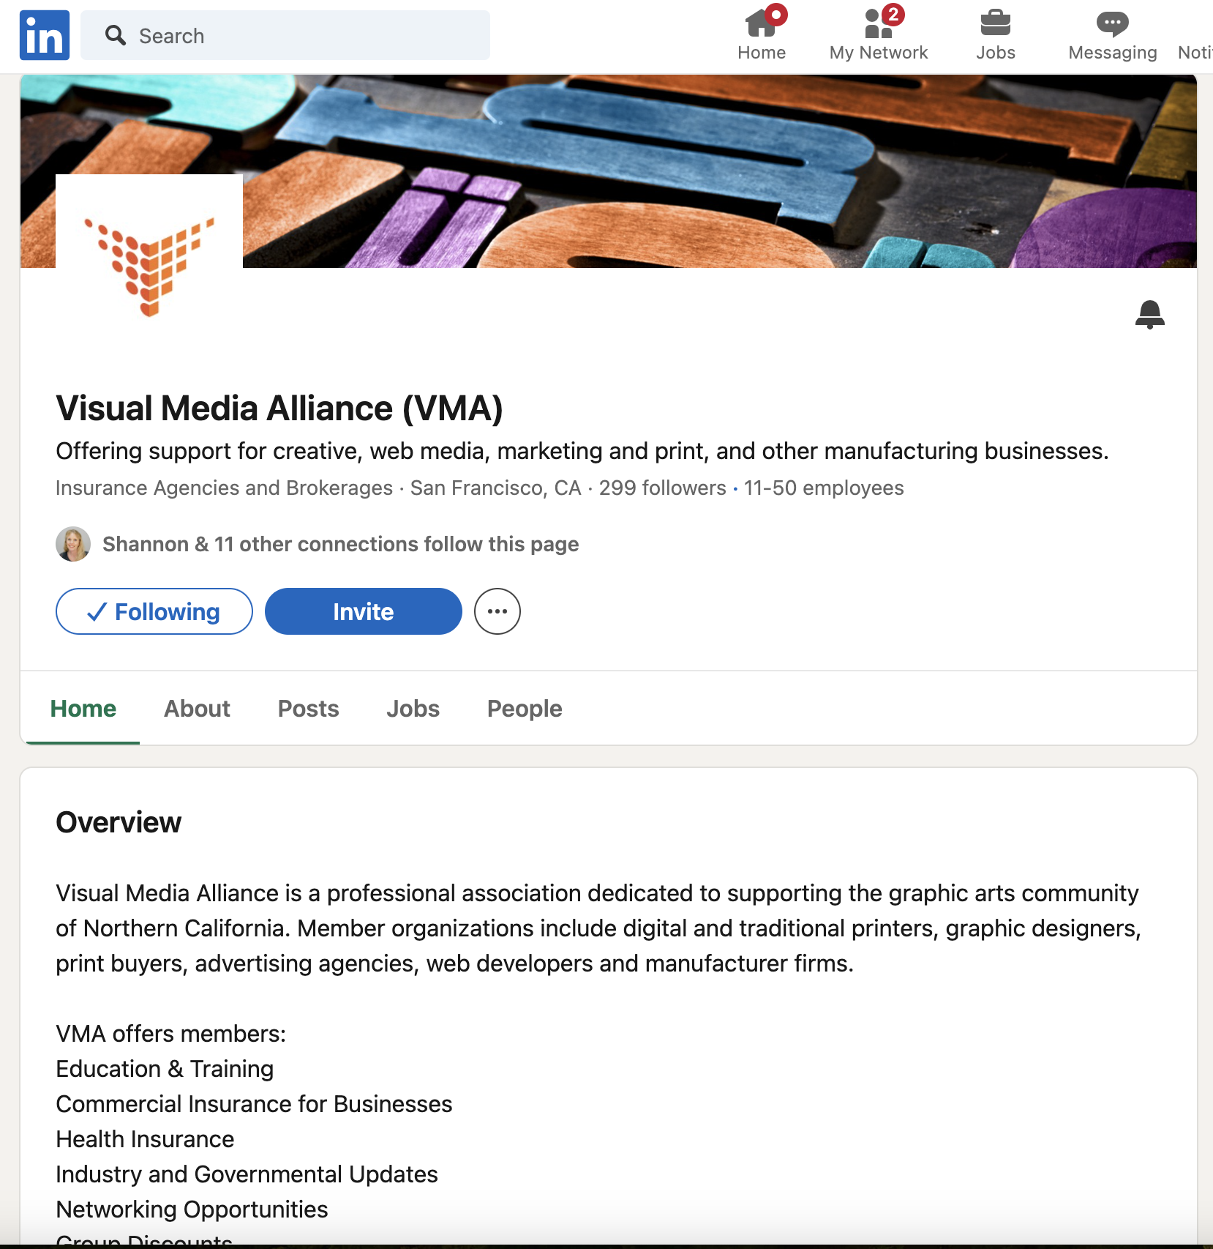
How to Update Your Business Headline
Directions:
Log into Your LinkedIn Company Page: Navigate to your company page as an admin.
Click “Edit Page”: Find the pencil/edit icon near the top of the page.
Update the Tagline Section: This is where you’ll include trending or relevant keywords related to your industry.
Incorporate Call-to-Actions (Optional): Add a brief call-to-action that aligns with your business goals, like “Contact us for your next print project.”

Slide 7
Keywords
Keyword Tips:
Keep to 220 character limit (including spaces).
Use clear concise language
Ensure it describes your business and services.
Use vertical bars (|) for separation: This helps break up the information, making it easier for readers to scan and understand quickly.
Include relevant keywords that are both specific and likely to be searched by your target audience.
Use clear, concise language that describes your business and services.
Example: Instead of “Quality Print Solutions,” use “Custom Printing for Small Businesses | Graphic Design Services | Eco-Friendly Options.”
Research Trending Keywords:
  Identify terms potential clients are searching for. Use tools like Google Trends, LinkedIn search suggestions, or relevant industry jargon.
  For instance:
    Trending keywords for print businesses: “Sustainable printing,” “Custom packaging design,” “Print marketing solutions.”

Slide 8
Updating LI Headline, Example: VMA
Accelerating Success for Print, Design, and Marketing Businesses | Networking, Sales Growth, Education & More | Elevate Your Business Potential, Become A Member Today
Keywords:
Benefit to customer and prospect:
Strong Call to Action:
Print
Design
Marketing
Businesses
Networking
Sales
Growth
Education
Success
Join
Networking
Sales Growth
Education & More
Elevate Your Business Potential
Become a Member
Urgency: today

Slide 9
2. Add a Custom CTA to Your Profile
The Why:
Drive Traffic. Adding a CTA button like “Contact Us” or “View Portfolio” directs visitors to your website or contact form, making it easy for them to engage with your business.
Minimal Setup, Big Impact. LinkedIn’s CTA feature is simple to add and can immediately boost traffic to key pages without much effort.
Improve Conversion. A clear CTA encourages immediate action, making it easier for potential clients to connect with you.
The Where:
The CTA goes in the "Contact Info" section or headline of your profile. It’s a clear, clickable button that can be customized to suit your business needs.
The How for the "Content Info" Section:
Log in to LinkedIn and go to your profile.
Click "Edit Profile" (the pencil icon).
Scroll to "Contact Info" and click the edit icon.
Add a Custom CTA Button:
  Choose from available options like “Contact Us,” “View Portfolio,” or create a custom CTA like "Get a Quote."
Save Changes.

Slide 10
VMA Example
VMA Keywords
Target Audience: “Small Business Owners” “Printers and Graphic Designers” “Creative Professionals | Services Offered: “Business Resources” “Insurance Solutions” “Marketing Support” “Advocacy for Printing | Industry-Specific: “Printing and Design” “Graphic Arts” “Visual Media” “Creative Services” | Value-Added: “Community” “Networking” “Workshops” “Sustainability”
Examples of Optimized Headlines for VMA with CTAs:
“Resources for Printers, Graphic Designers, and Creative Professionals | Contact Us for More Info”
“Empowering Visual Media Professionals with Insurance, Marketing, and Community Resources | Get a Quote Today”
“Printing & Graphic Arts Solutions | Explore Our Portfolio”

Slide 11
3. Celebrate Milestones Publicly
The Why:
Showcase Business Growth. Highlight your achievements to demonstrate your success and credibility.
Stay Top of Mind. Regular updates keep your business visible in your network.
Build Community. Sharing accomplishments invites congratulations and fosters stronger connections.
Encourage Engagement. Milestones often spark likes, comments, and shares from your audience.
The Where:
Share on your LinkedIn profile, company page, or in relevant groups to maximize visibility and engagement.

Slide 12
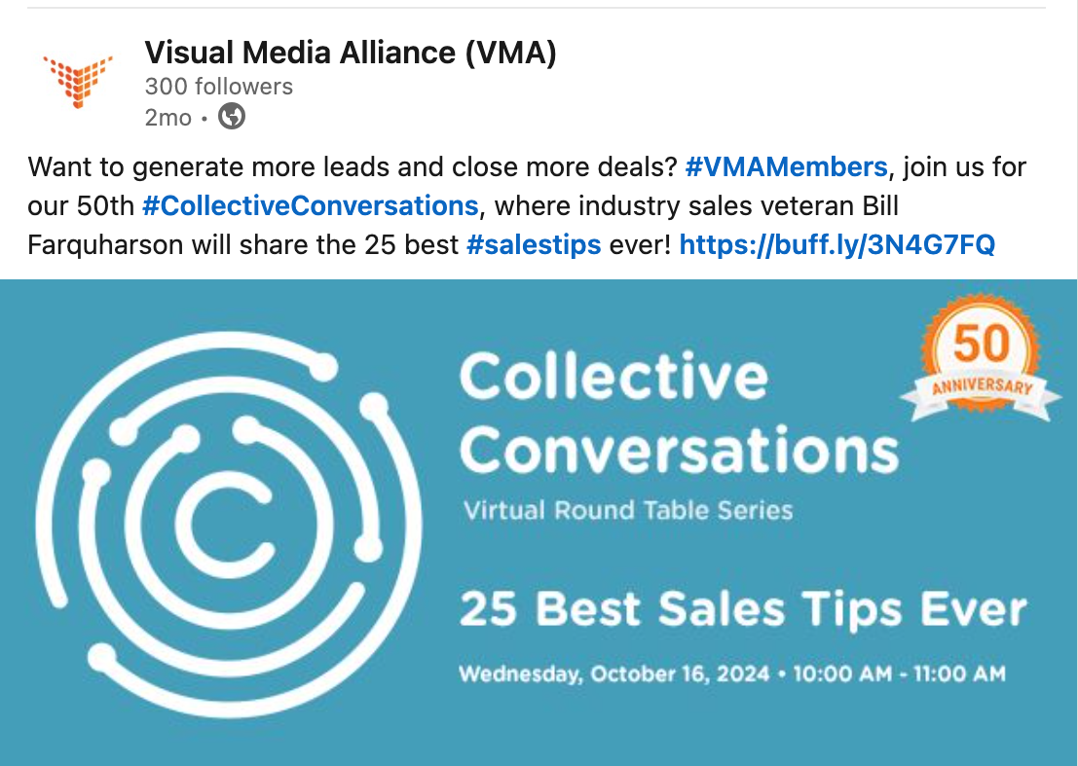
3. Celebrate Milestones Publicly
The How:
Pick a Milestone
  Examples:
    Business anniversaries
    Signing a new client
    Completing a big project
Write a Post
  Share what the milestone means for your business, and thank those who contributed.
Add Visuals
  Include photos, a video, or a graphic showcasing the achievement.
Tag Relevant People
  Mention collaborators, team members, or clients to broaden the post’s reach.
Include a Call to Action
  Encourage your audience to celebrate with you, share your services, or learn more about your work.

Slide 13
4. Send a LinkedIn Welcome Message
The Why:
Build Instant Rapport. Start conversations with new connections on a positive note.
Highlight Your Business. Introduce your services in a friendly, non-intrusive way.
Create Future Opportunities. Open the door to collaborations, referrals, or partnerships.
Show Professionalism. A personalized message makes a strong first impression.
The Who:
New Connections in Your Industry - peers, collaborators, and potential clients.
Potential Clients or Partners - Introduce your business to those who may need your services or want to collaborate.
Vendors or Service Providers - Start conversations with businesses you work with or might need support from.
Community Influencers - Engage thought leaders or active contributors in your niche to expand your network.
Event or Group Connections - Welcome people you’ve connected with through events, webinars, or LinkedIn groups.
The Where:
Send messages through LinkedIn’s Messaging feature. They appear directly in your connection’s inbox.

Slide 14
4. Send a LinkedIn Welcome Message
Free Option
Sending messages to your 1st-degree connections is free and unlimited.
Messages sent through LinkedIn Groups or shared events may also be free.
One-at-a-Time Messages (Free)
Best for personalized, meaningful engagement.
Recommended when building stronger relationships with high-value connections.
You can send a message right after a connection is accepted via their profile or LinkedIn Messaging.
Hi [First Name],
Welcome to the [Association Name]! 🎉 I'm Shannon, Director of Membership at VMA, and I’m excited to have you join our community.
As a member, you’ll have access to our networking events, discounts program, education programs that can help you save time and money.
If you have any questions or need help navigating our offerings, feel free to reach out—I’m here to support you!
Looking forward to seeing you at [mention an upcoming event or opportunity]!
Best,
Shannon Wolford
Director of Membership
Visual Media Alliance
415-710-0567

Slide 15
4. Send a LinkedIn Welcome Message
Paid Options
InMail Messages: Available only to Premium users; useful for reaching out to people outside your network.
Bulk Messaging
  Available with LinkedIn Premium or Sales Navigator.
  Use tools like InMail Campaigns or connection filters to send messages to multiple recipients.
  Great for outreach campaigns but less personal than one-at-a-time messages.

Slide 16
5. Collaborative Content Creation
The Why:
Co-creating content with thought leaders, partners, or influencers amplifies your message by leveraging shared expertise and extending your reach to new, relevant audiences.
This tactic builds credibility and fosters relationships within the industry.
The What: Co-create articles, design, video
  Google Docs or Microsoft Office
  Canva for Teams
    Allows users to invite collaborators to work on the same design simultaneously.
  Adobe Express (formerly Adobe Spark)
    Enables collaborative design by sharing editable links with team members. You can co-create and make changes together, similar to Canva.
  Adobe Creative Cloud (Photoshop, Illustrator, InDesign, etc.)
    Supports cloud documents that allow for collaborative editing. Multiple users can access and edit the document (though not in real-time as seamlessly as Canva, unless using Adobe XD for more interactive
  Lumen5 (AI Video Creation)
    Lumen5 uses AI to transform text into engaging videos, which can be great for collaborative video content creation. Multiple team members can work on the same project, editing, fine-tuning, and adding elements like captions, images, and logos.
  Runway (Video Creation)
    Runway is a creative suite that combines AI with creative tools for video editing, design, and content creation. It allows for real-time collaboration, and its AI features can assist in tasks like text-to-video generation, removing backgrounds from images, and suggesting video edits.

Slide 17
The How:
Identify potential collaborators with aligned goals and audiences.
Reach out with a proposal that highlights mutual benefits.
Use off-LI co-authoring tools, or external tools like Google Docs, to create videos or webinars, ensuring the content reflects both brands.
Publish and promote on LinkedIn, tagging collaborators to maximize engagement.
Engage with your audience in the comments and encourage further discussion.
5. Collaborative Content Creation
The Where:
Promote the content through LinkedIn posts, newsletters, and industry-specific groups.
Publish long-form content that showcases thought leadership on LinkedIn Articles
Co-host webinars or panel discussions on LinkedIn Live to , enabling real-time engagement.
Share bite-sized co-created off of LI insights and visual content on a LinkedIn Posts or Carousels
Participate in LinkedIn Groups within the print and graphic arts industry to share and discuss collaborative content.
How many people currently some sort of collaborative content creation internally or with other companies?

Slide 18
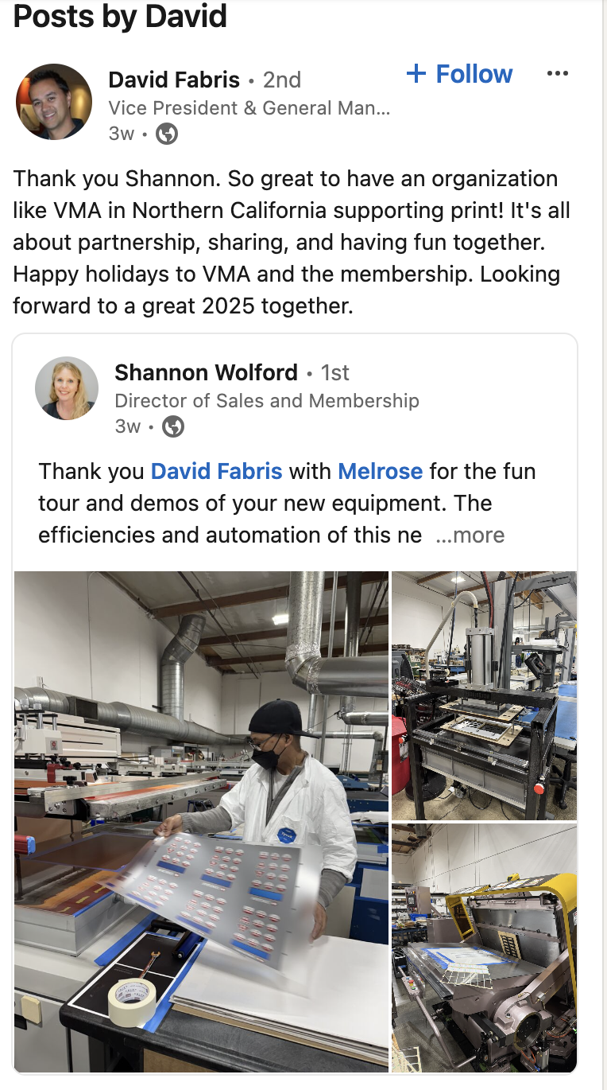
6. Post-Purchase Engagement for B2B
The Why:
Creates organic social proof that builds trust, credibility, and a stronger reputation for your business.
Encourage repeat business and referrals, fostering long-term relationships.
The What:
Ask satisfied customers to publicly share their reviews, testimonials, and experiences with your product or service.
Content can include:
  Customer success stories
  Written testimonials
  Video reviews or shout-outs
  Case studies showcasing measurable outcomes or benefits
Image
Try to get a member doing this or make one for VMA

Slide 19
6. Post-Purchase Engagement for B2B
The What:
Reach out to satisfied customers post-purchase and ask if they'd be willing to share a review or testimonial on LinkedIn.
Provide simple guidance on how to leave a review or share a success story, making the process easy and clear.
Encourage them to tag your company and share the content with their network.
Show appreciation by acknowledging and thanking customers publicly when they share their experience, fostering further goodwill.
Amplify the content by resharing or engaging with it on your company’s LinkedIn profile, extending its reach.
Is anyone doing having customers share on LI for them?
The Where:
On LinkedIn Posts: Encourage customers to share reviews, testimonials, or success stories directly on their profiles, tagging your company to amplify the message.
LinkedIn Articles: If customers are willing, ask them to co-author a case study or success story, detailing how your product/service helped their business.
LinkedIn Recommendations: Encourage customers to leave written recommendations on your LinkedIn profile to boost credibility.
LinkedIn Messages: Use direct messages to follow up with clients, thanking them for their purchase and encouraging them to share their experience.

Slide 20
Collective
Conversations
Thank you for joining us!
Register for upcoming Collective Conversations
and find slides at vma.bz/cc/

