Slide 1

Collective
Conversations
Virtual Round Table Series
DIY Web Design Best Practices
May 22, 2024 @ 10AM
Kathy Warren
Graphic and Web Designer
Visual Media Alliance

Slide 2

Why should we care so much about web design?
Your website is a sales rep for your business 24 hours a day 365 days a year
Your website is a platform for:
  Showcasing services/products
  Interacting with customers
  Lead and sales generation
Your website is the first impression you may have on a potential customer
Notes:
Your website is representing your business 24 hours a day 365 days a year
It can serve central platform for your business to showcase services, interact with customers, generate leads, and ultimately drive sales, all around the clock. It's like having a storefront that never closes, and accessible to potential customers anytime, anywhere with an internet connection.
This why being thoughtful strategic with you web design is important, it not only can drive engagement sales but it may be the first interaction a potential customer has with your business which is why we want to make sure that we are putting our best foot forward.
1. https://www.tandfonline.com/doi/abs/10.1080/01449290500330448

Slide 3
A little data:
We have 50 milliseconds to make a good first impression online¹
94% of first impressions of a website are design related²
50% of consumers state that their impression of a brand is dependent on the design of the company's website³
88% of online consumers are less likely to return to a site after a bad experience⁴
Notes:
Here is a little data that you may not be aware of
We have 50 milliseconds to make a good first impression online.¹ That is .05 seconds
which not a long time
94% of first impressions of a website are design related²
50% of consumers state that their impression of a brand is dependent on the design of the company's website³
88% of online users are less likely to return to a site after a bad experience⁴
88% is A LOT! This means that a poorly designed website with poor ux can and will turn potential customers away before they even have a chance to explore your services/products or get to know your business
https://www.tandfonline.com/doi/abs/10.1080/01449290500330448
https://marketsplash.com/ux-statistics/
https://www.prnewswire.com/news-releases/half-of-consumers-consider-a-companys-website-design-crucial-to-their-opinion-of-that-brand-301274695.html
https://blog.hubspot.com/website/ux-audit#:~:text=Research%20supports%20this%20%E2%80%94%2088%25%20of,highlight%20gaps%20to%20improve%20personalization.

Slide 4
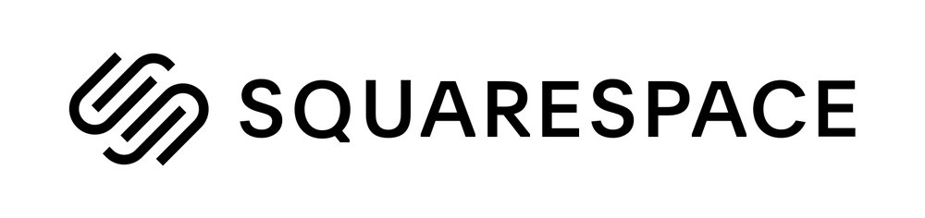


What are you currently using?
HTML
CSS
JS
Notes:
There are a lot of tools out there to develop and design websites these days. I am curious to know what you and your business may be using?
when web design first began, We only had the ability to use HTML code to lay out the basic structure of a webpage. The HTML code provided the essential framework, but the pages were often plain and lacked much visual appeal.
Then came the game-changer: Cascading Style Sheets (CSS). With CSS, we could bring web pages to life. allowing us to design layouts, change fonts, add colors, and create visually appealing experiance online.
the evolution didn’t stop there. Enter JavaScript—the magic wand of web development. JavaScript allowed us to make our websites more dynamic and interactive. It transformed static pages into engaging experiences. With JavaScript, we could add animations, handle user inputs, and even fetch data from servers without reloading the page.
During this era of web design and development you needed knowledge of coding to create a website.
Since then there have been the development of many low code and no code tools to create websites.
Wordpress, Squarespace, Wix, WebFlow, they are all wysiwyg builders, that stands for what you see if what you get which. These are visual design tools that give us the ability to drag and drop elements onto the page to design. These wysiwyg editors also generate html, css and JS. I explain this because later on I will touch on H1 tags meta tags and descriptions and these are part of the HTML of your site.
There are so many options out there can get overwhelming. If you are DIYing. I say go with what you have the capacity to learn and how complex in web design development you would like to go.

Slide 5
It all starts with research:
Identify your target audience and their needs
Research competitor websites:
  See what they are doing
  What is working and what isn’t working
  Gain possible inspiration
Define the goals of your website
  Generate leads
  Educational
  Building a community
  Sell a product/service
Next step is visual site mapping/information architecture
Research
User Experience
Define CTA
Accessibility
Visual Design
Optimize for Mobile
Simple SEO
Additional Resources
Notes:
On the right hand side of the screen you can see a menu these are the topics we are going to be covering today.
Before you start designing any pages spend some time doing a bit of research on target audience, and their needs.
Research competitor websites to see what they are doing, possible inspiration or insight into what doesn’t work. I also recommend looking at website outside your industry, inspiration can be found anywhere.
Define the goal of your site as a whole. Do you want your website to generate leads? Do you want it to be strictly education build community or sell a product or service.
After defining the website goal we want to layout the visual site map for the site. The visual site map is a representation of the pages that will be on the site and how the user will navigate to them. This determines the site structure and organization of pages. There XML site maps which are written in XML code but we will not get into creating those today. Those are what the search engines use to crawl your site. If you are using a modern wysywig builder they are generated automatically.

Slide 6
Example of a Visual Site Map:
Research
User Experience
Define CTA
Accessibility
Visual Design
Optimize for Mobile
Simple SEO
Additional Resources
Home
About
Services
Our Work
Blog
Contact
Team
Service 1
Example 1
Blog Post 1
Service 2
Example 2
Blog Post 2
Example 3
Blog Post 3
Blog Post 4

Slide 7
Research:
Research
User Experience
Define CTA
Accessibility
Visual Design
Optimize for Mobile
Simple SEO
Additional Resources
Then define the goal of each page
A page goal could be to:
    Educate or give an overview of company
    Product/Service Showcase
    Demonstrate expertise in the industry
    Lead Generation
    Portfolio/Case Studies
    Testimonials
Defining the page goal early will help us later on when we begin the visual design process
Notes:
After laying out what pages are going to be on the site and how they will flow we want to then define the purpose of the page, This happens before any design or content creation.
What do you want the user to do? What is the main goal of the page?
Some examples of a webpage goal would be
Educate or give an overview of company
Product/Service Showcase
Demonstrate expertise in the industry
Lead Generation
Portfolio/Case Studies
Testimonials
Defining the page goal early will help us later on when we begin the visual design process as it will help to determine what content is on the page and how it flows. Before we start diving into design in each page we need to have an understanding of user experience and why it is so important.

Slide 8
What is User Experience?
Research
User Experience
Define CTA
Accessibility
Visual Design
Optimize for Mobile
Simple SEO
Additional Resources
The overall experience that a user has while using a website
This is a large umbrella that includes:
  How a user feels when using your site
  Ease of use
  Relevant content
  Responsive design
  Accessibility
Notes:
What is user experience. The overall experience that a user has while using a website
This is a broad category that includes:
How a user feels when they use your site. Does the user feel frustrated, happy, empowered.
How easy is the site to use: including navigation, ability to complete tasks and find desired information.
How relevant the content is. Relevant content is important for ux because when users find what they are looking for easily, their experience is positive, which will encourage repeat visits.
Can you recall a time when went to a site looking for specific information and were unable to find it. How does that make you feel as a user? What do you end up doing? Yes leaving the site and going else where. We don’t want that we want to keep our users on the site as long as possible right?
Responsive design is important for user experience this is what makes your website work on any size device from a large desktop screen to mobile phone. A responsive design will adapt the website content to the screen size, making it easier for users to interact with the site.
Accessibility is another aspect of UX: Is your site accessible to all users including those who may have disabilities or visual impairments. We will go into more detail about accessibility a little later in the presentation.

Slide 9
User Experience:
Consistency and cohesiveness are key to good user experience
  Define the following:
    Color pallet, typography, and imagery style
Keep the end user in mind when designing
  Approach design of a website with a first-time visitor in mind
Keep menu navigation simple
  Use common words, no jargon
  Clear titles for pages
  Placement matters, do what people will expect
  Simple is (usually) better!
Research
User Experience
Define CTA
Accessibility
Visual Design
Optimize for Mobile
Simple SEO
Additional Resources
Notes:
Consistency is key to good user experience. Have you ever visited a site and clicked on a subpage or a link and the page you landed on looked so different that you thought you were in the wrong place or landed on a different site? We don’t want that for our users! It can create confusion and damage brand credibility.
To ensure we have a website that is cohesive we are going to want to define your color pallet, typography, and visual style for the site. You may already have brand guidelines in place which is great but if you do not I do recommend taking some time and get these elements defined. What we really want for a brand identity is for someone to be able to recognize your brand from anything that they come across that could be print collateral, social media and your website. We want to be consistent across all mediums to help aid in brand recognition.
Keep the end user in mind when designing and laying out your site. This is where your research is going to come in handy as it involves understanding the target market and designing the website in a way that meets their needs and expectations. I personally think it is a good idea to approach the design of a website with a first-time visitor in mind. First-time users know nothing about our website and layout and structure. So when we design with them in mind it helps to ensure that navigation is intuitive and the site is user-friendly
Keep menu navigation simple. you have a navigation that is overly complex, hidden behind an unrecognizable icon, or not intuitive it will lead to increased user frustration. What happens when a user is frustrated with a website?

Slide 10
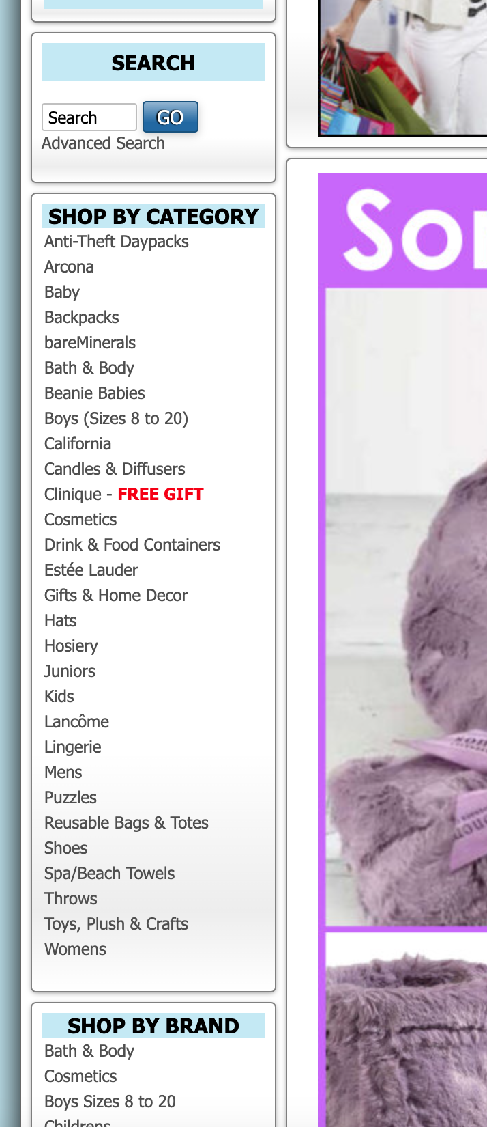
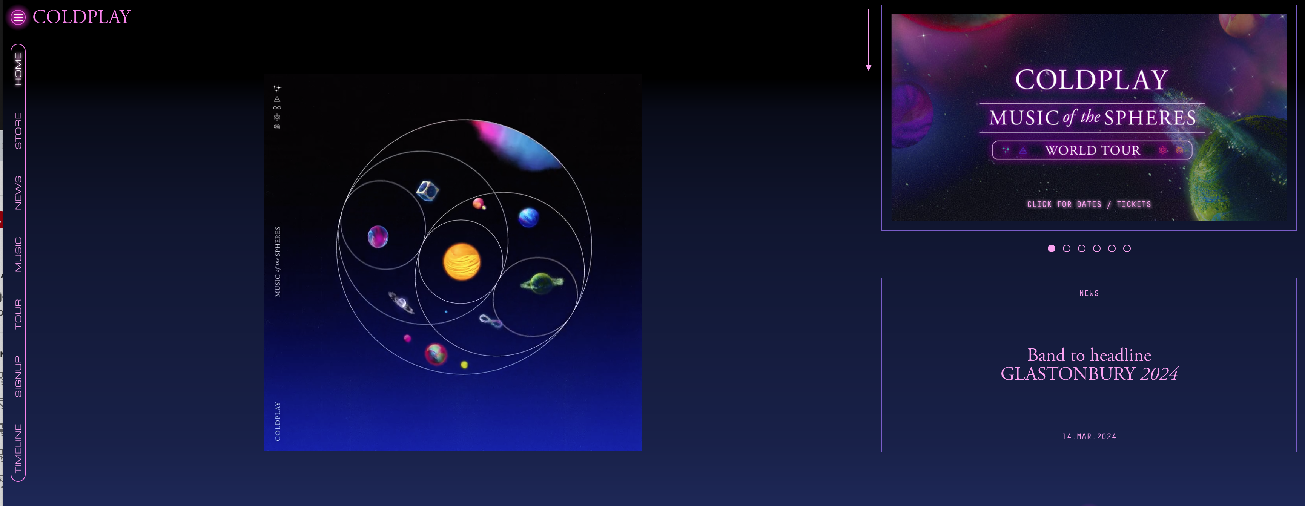
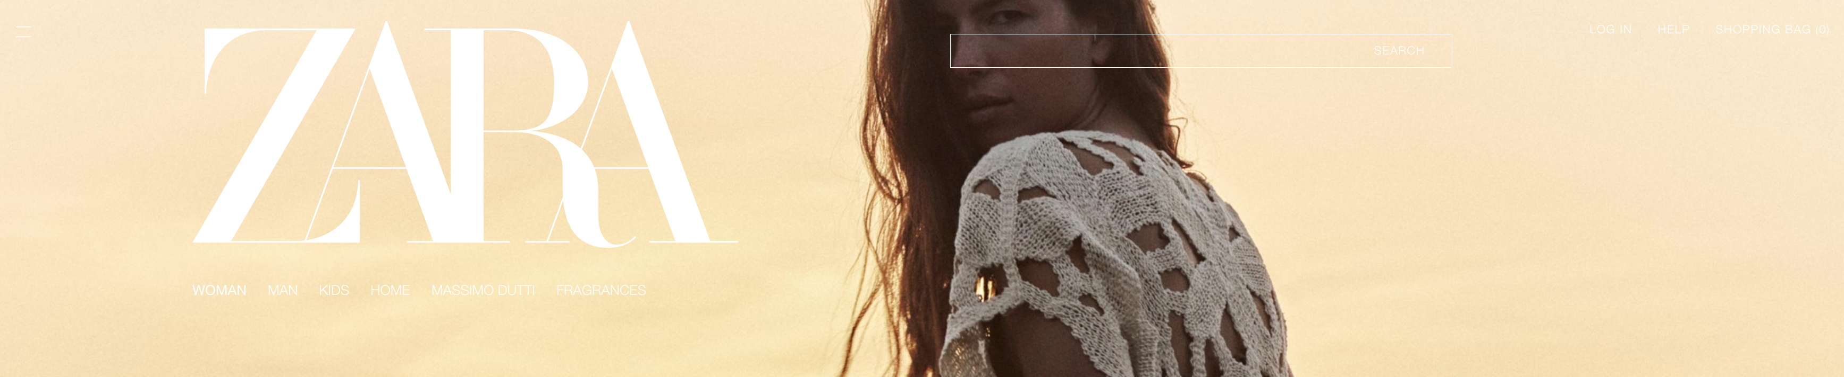
Examples of “bad” navigation:
3
1
2
Notes:
Here are a few examples of navigation. Can you tell me what you think can be improved with each? Lets start with #1
This is from the Coldplay website - Menu location not where the user would expect
How about #2 the Zara menu : Menu location, Color contrast, Ease of use if you cant see the menu you cant use it can you!
Now #3 is from a local department store here in the bay area. What are your thoughts on this one?– Overly complicated menu- This menu could be simplified making it easier to use and naviagate through. To be honest its like looking at amazon in 1999

Slide 11
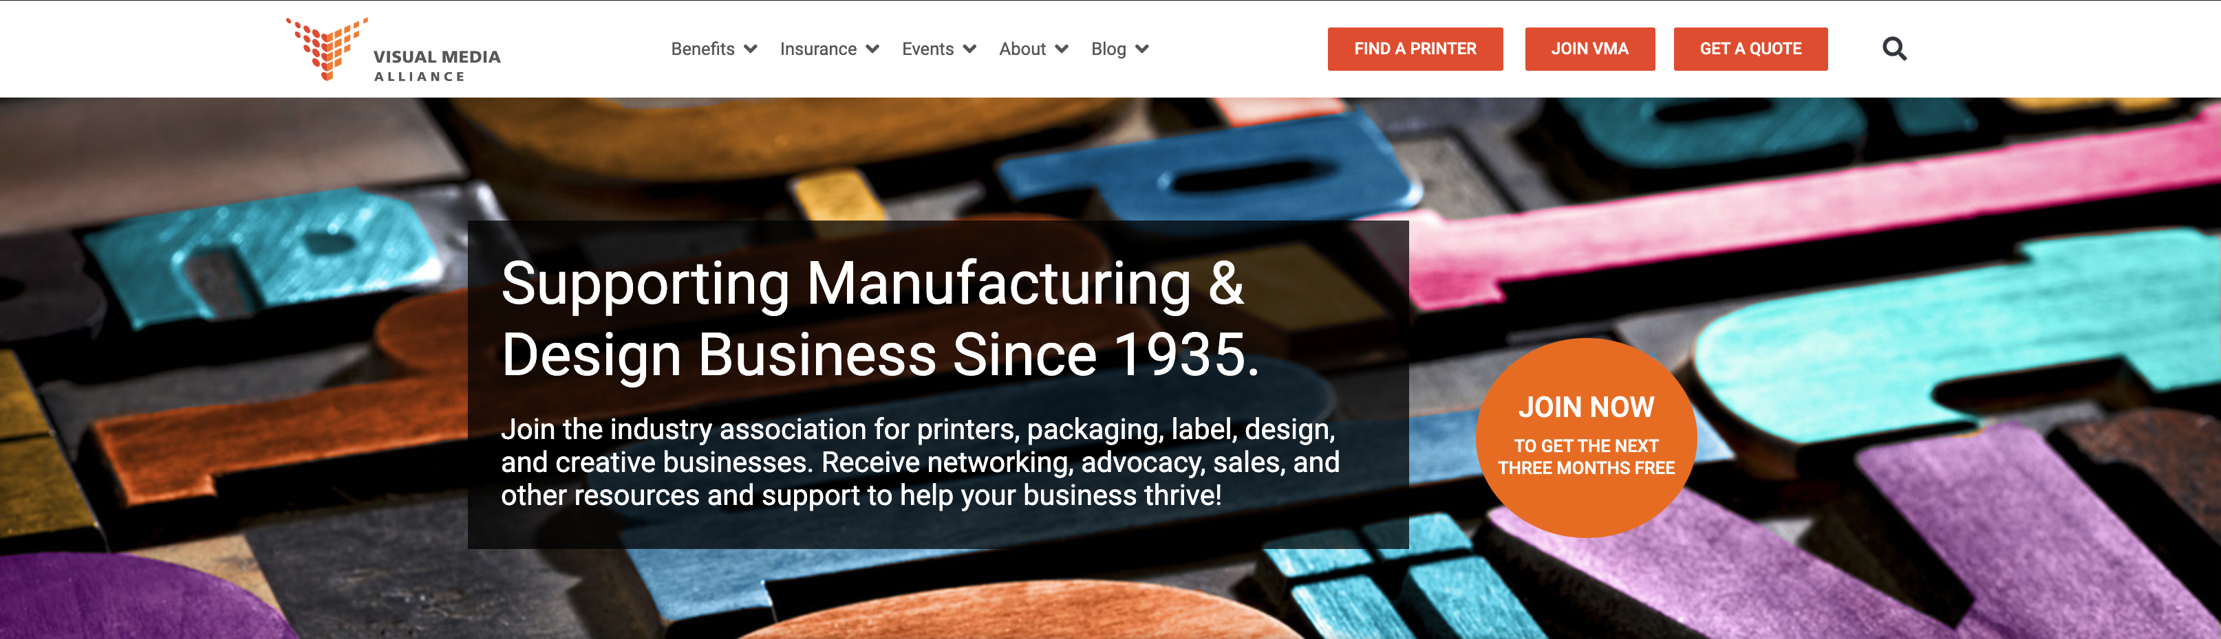
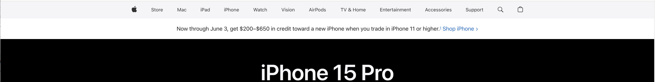
Examples of great navigation:
1
2
Notes:
Here are a few examples of great navigation. What these all have in common is the navigation is where the target audience would expect it to be, it is clear and easy to read with no accessibility issues.

Slide 12

Create the Call to Action:
Research
User Experience
Define CTA
Accessibility
Visual Design
Optimize for Mobile
Simple SEO
Additional Resources
CTA Is a prompt that encourages users to take a specific action
  Request a quote, download a resource, fill out a form or subscribe to an email list
This will help guide the page content and copy
Limit the number of CTAs
Create visual contrast
Keep it simple!
Notes:
Now that we have defined the the page goal and have our user in mind we are going to move on to creating our main CTA for the page we are working on.
The CTA is a prompt on the webpage that encourages users to take a specific action, This can be anything from having the user request a quote, download a resource, fill out a form or subscribe to an email list.
Defining the call to action will help guide the pages content and copy. Ensures that all elements of the page work together to lead the user towards the desired action
While there are no set in stone rules on how many CTA’s a page can have, we want to keep in mind when there are too many options competing for attention it can overwhelm user, leading them to miss the main CTA
One rule of thumb which I use when designing is to only have one CTA showing on the viewport at any given time. This does not include the top navigation bar and you can also have secondary call to actions but keeping one main clear CTA helps to ensure we are leading the user to the action or task we would like them to complete.
Make your CTA stand out visually by using contrasting colors, bold typography, or distinctive button styles and color blocks.
Keep your CTA simple and to the point. Try to be concise with your messaging to make it easy for users to understand and digest quickly.

Slide 13
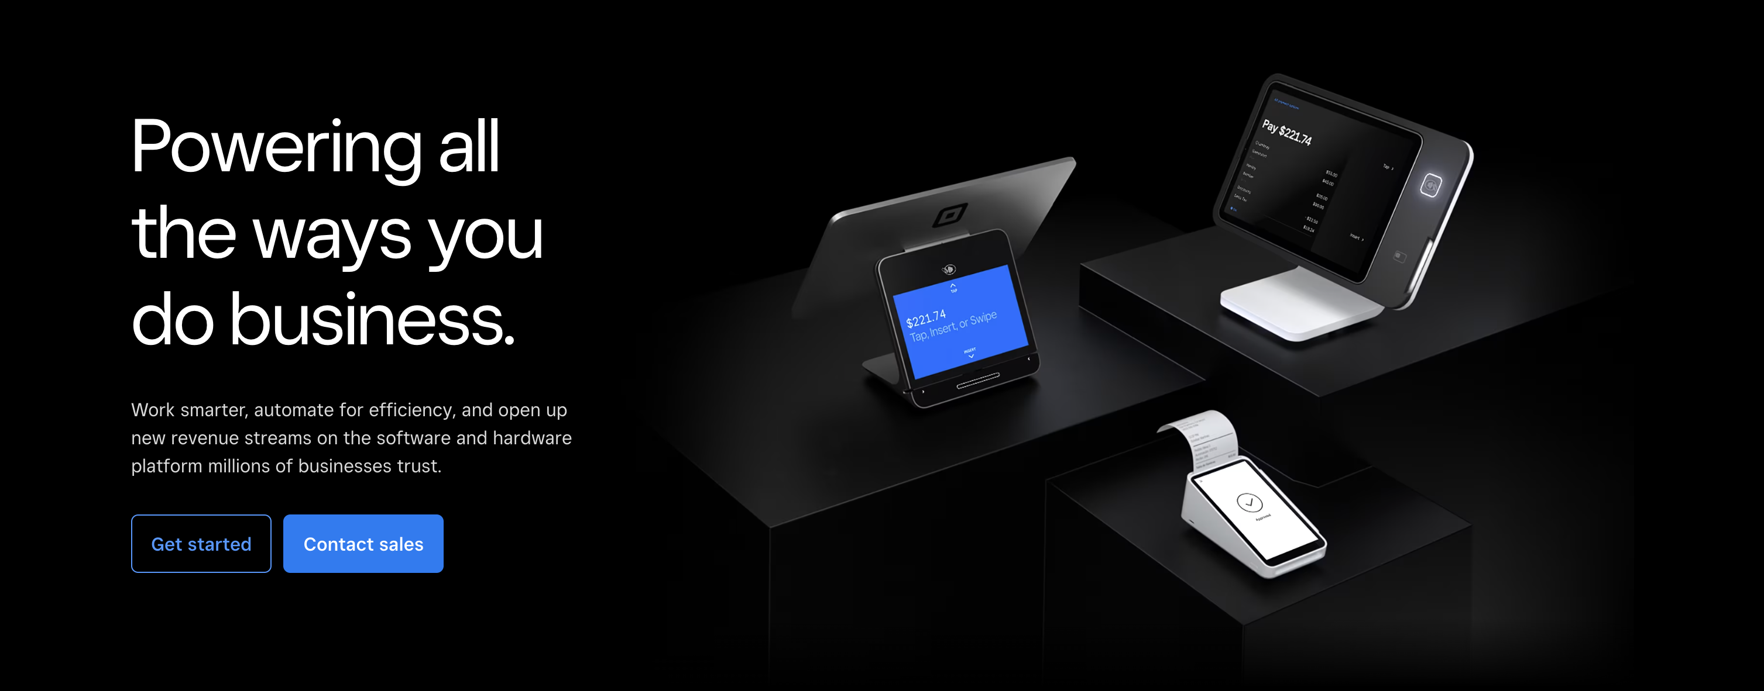

Call to Action Examples:
Notes:
Here are some good examples of call to actions on a website. They both are using the principles of design to draw the user in and lead them to take an action.

Slide 14
Accessibility:
Important for user experience but also the law!
Alt text for images and icons
Captions for video and audio
Clear labels on forms
Clear error messages
Color contrast
  Use high contrast colors for on page text and buttons
  Use a color checker to make sure you are WCAG compliant
    https://accessibleweb.com/color-contrast-checker/
    https://webaim.org/resources/contrastchecker/
    https://dequeuniversity.com/color-contrast
Research
User Experience
Define CTA
Accessibility
Visual Design
Optimize for Mobile
Simple SEO
Additional Resources
Notes:
Once we have defined our call to action and are ready to move on to visual design we want to keep accessibility in mind. This is not just important for user experience but it is also the law!
The ADA American Disability Act requires that websites be accessible to people with disabilities.
Basic accessibility standards for web design are to include:
Alternative text for images and icons
Captions for videos and audo
Clear labels on forms
Error messages
And Color contrast
We want to make sure that users don’t have any issues with readability to ensure that we want to use high contrast colors for buttons and body text. This will not only boost ux but it will also ensure you are WCAG compliant. You can utilize a color checker to be on the safe side.

Slide 15
Accessibility: What is WCAG?
WCAG is the Web Content Accessibility Guidelines
Guidelines were created to make the web more accessible to everyone, including people with disabilities
Three levels of conformance:
  Level A: Lowest level focusing on most basic accessibility features
  Level AA: Mid-level most commonly targeted level
  Level AAA: The highest level of conformance and also the hardest to achieve
  Learn more at https://www.w3.org/WAI/standards-guidelines/wcag/
Research
User Experience
Define CTA
Accessibility
Visual Design
Optimize for Mobile
Simple SEO
Additional Resources
Notes:
I mentioned WCAG on the slide before and I want to make sure I explain what this is. WCAG is the Web Content Accessibility Guidelines. These guidelines were created to make the web more accessible to everyone, including people with disabilities.
WCAG has different levels of conformance: A, AA, and AAA. These levels indicate the degree to which a website meets the accessibility standards.
Level A Ensures basic web accessibility and includes the most critical accessibility requirements.
Level AA is the industry standard is the most commonly targeted level and deals with the biggest and most common barriers for disabled users, providing a medium level of accessibility.
AAA is the highest level of conformance, focusing on the most advanced accessibility features.
This is a very high level overview of the guidelines you can learn more at W3.org. In general if you are meeting all of the items listed on the previous screen your site will be in good shape. If anyone is concerned I can run an accessibility on the homepage of you site for free and this can give you a good overview of where your site is at and what needs improving.
Level AA Conformance:
Contrast (1.4.3): Ensure that text and images of text have a contrast ratio of at least 4.5:1, except for large text (18pt and bold) which should have a ratio of at least 3:1.
Keyboard Accessible (2.1.1): All functionality of the content is operable through a keyboard interface without requiring specific timings for individual keystrokes.
Error Identification (3.3.1): Provide descriptive error messages and suggest solutions to help users correct input errors.
Language of Page (3.1.1): Identify the primary natural language of the page to assist screen readers and other language processing technologies.

Slide 16
Accessibility Check:
Research
User Experience
Define CTA
Accessibility
Visual Design
Optimize for Mobile
Simple SEO
Additional Resources
LEARN MORE
This is some sample body copy text on a color block. Let’s see if it passes the accessibility check!

Slide 17
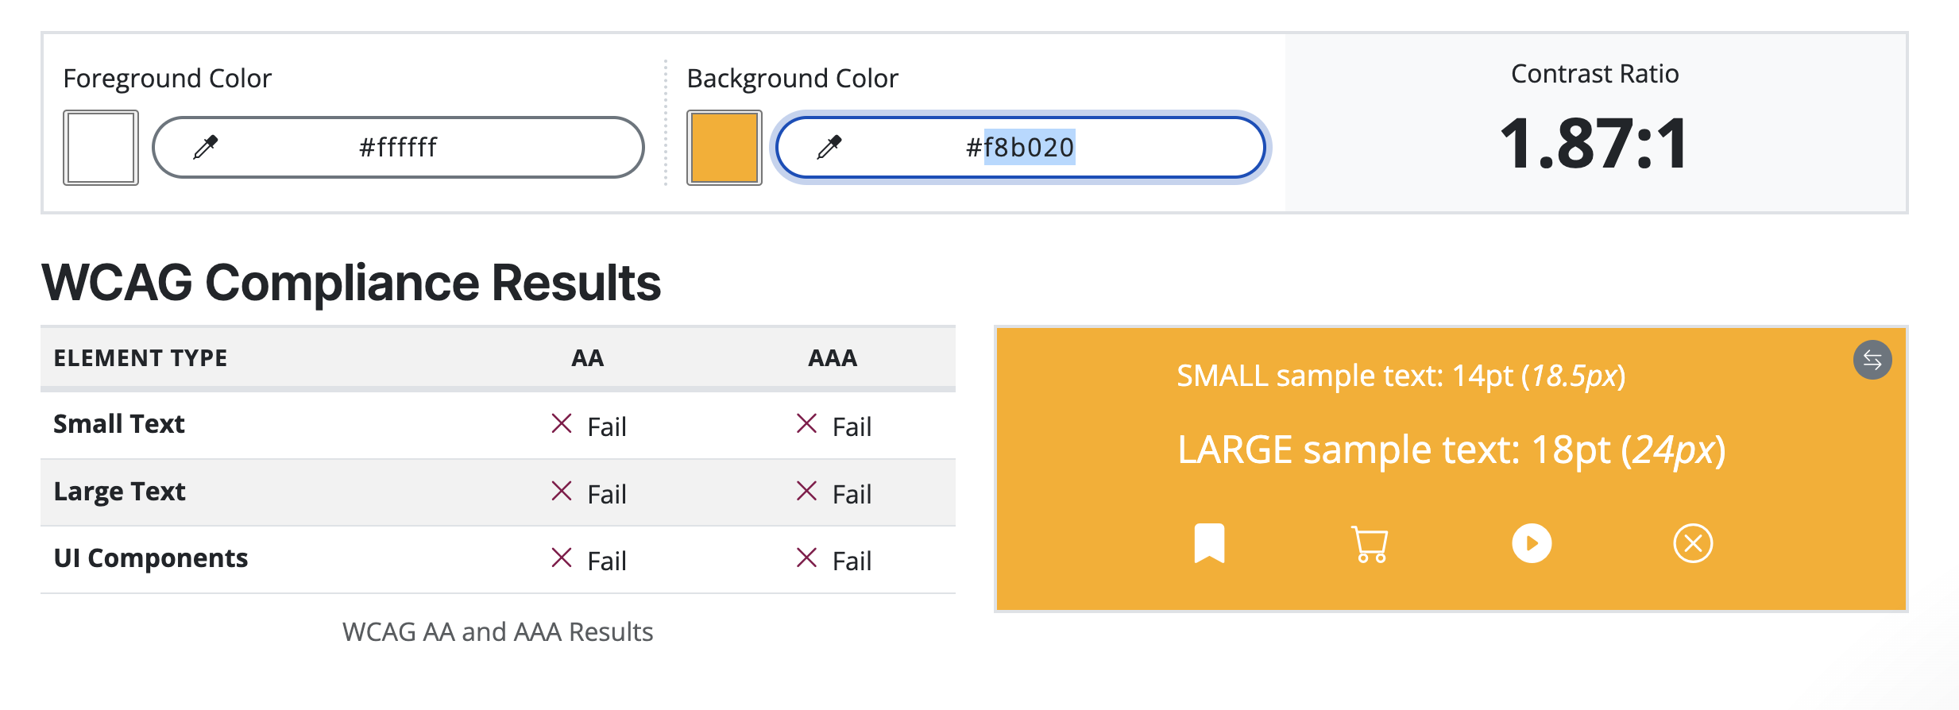
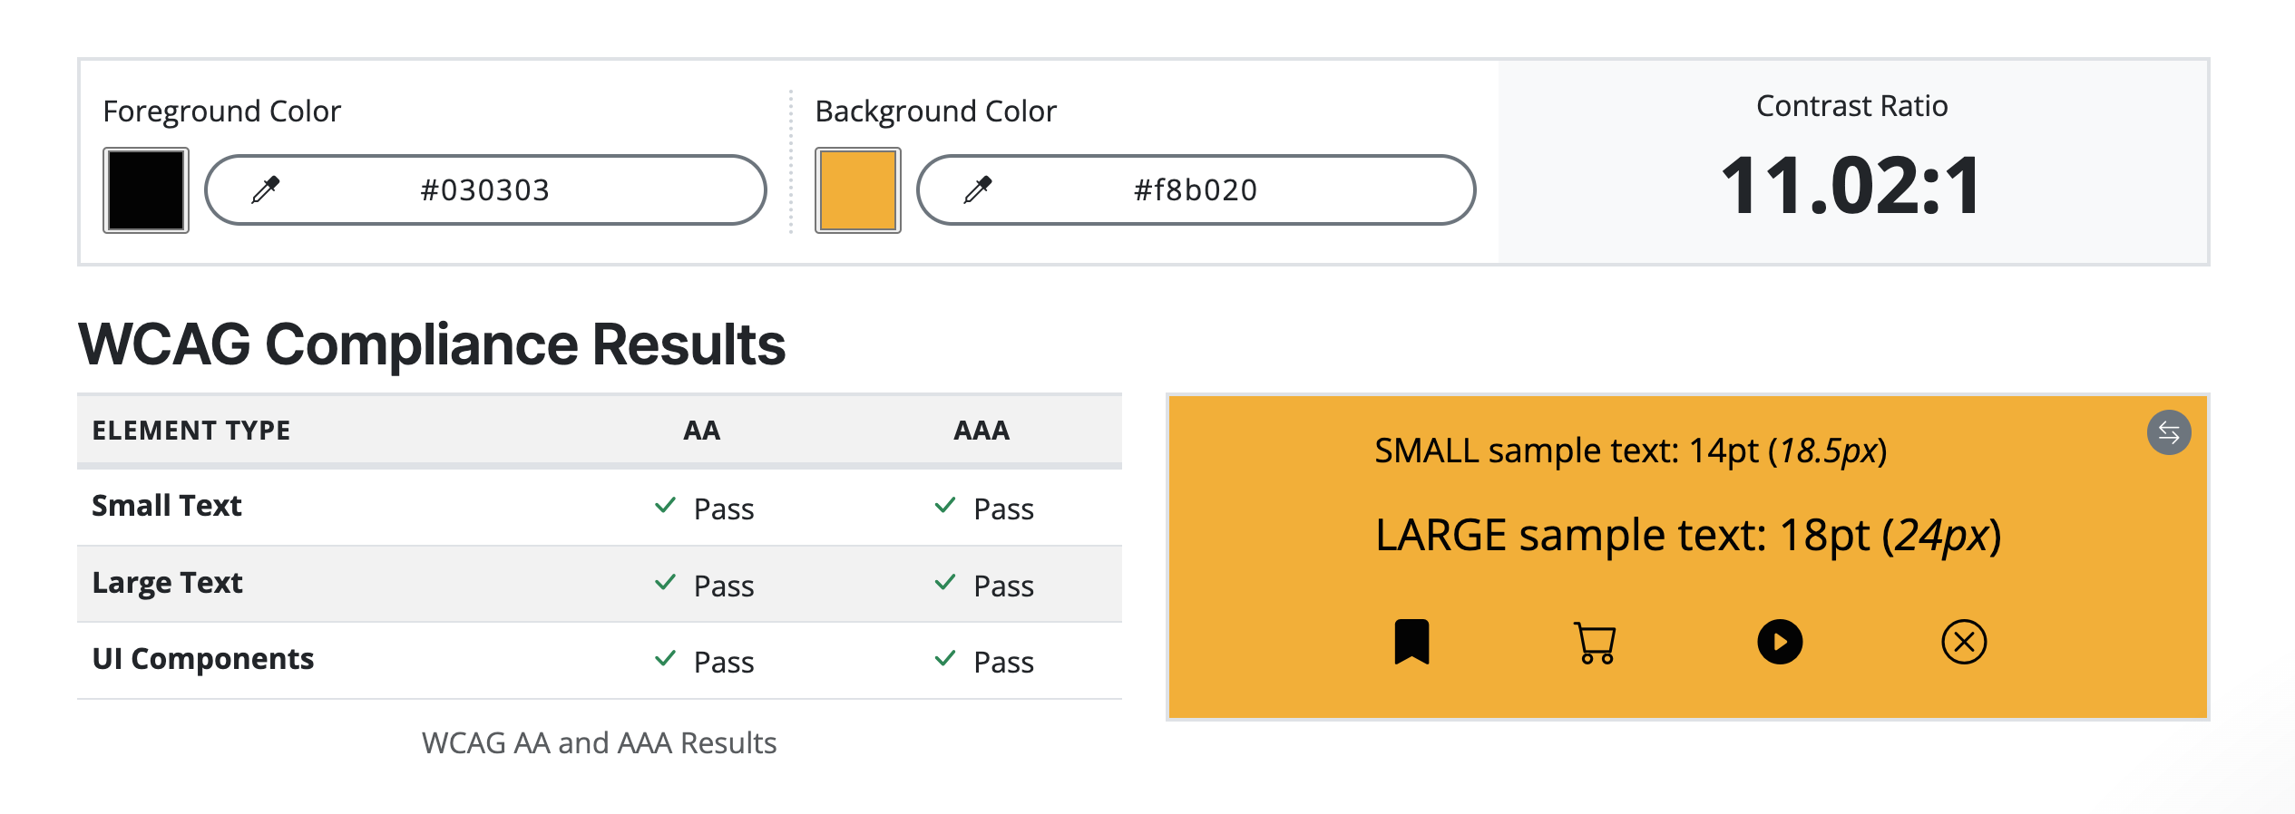
The Results:
Research
User Experience
Define CTA
Accessibility
Visual Design
Optimize for Mobile
Simple SEO
Additional Resources
LEARN MORE
LEARN MORE
Notes:
Here we have the results of running the color combination through the accessibility checker.
You can see on the tests checks three elements how the color contrast is on small text, which would be 14px or smaller and considered body copy on the page,
large text that is 24px or more so this would be titles on the page
and ui components these are icons that may be shown on the website, like links to social media.
This test runs the color combination through both the AA and AAA standards and you can see that the top combination failed both. So sometimes when we have a vision in mind for what we are going to use we need to be flexible in order to meet accessibility standards

Slide 18
Visual Design: On Page Hierarchy
Research
User Experience
Define CTA
Accessibility
Visual Design
Optimize for Mobile
Simple SEO
Additional Resources
Organize the content for the page first
  Think about it as a way to guide the user
  Organize from most important to least important
Create hierarchy on the page:
  Presenting the most important content more prominently than less critical information
  Improves readability by making it easier for users to scan
  Use color, contrast, white space, and scale
Notes:
Now we are going to start talking about individual pages. You want to take a moment to organize your content. Think about it as a way to guide the user through the page. As you scroll you want the most important at the top and the least important at the bottom. It is terrible user experience to have to scroll to the bottom of a long page to get to the main content or to compete a task.
You are going to want to Create hierarchy on the page. Much like print design this helps the guide the user through the page by Presenting the most important content more prominently. Will improves the readability of the page by making it easier to scan. This can be done a number of ways with use of color, contrast white space, and scale

Slide 19
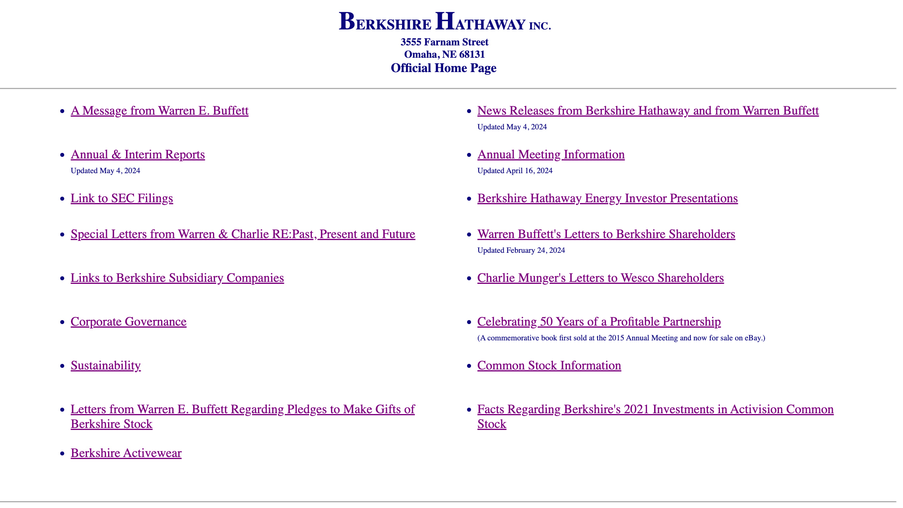
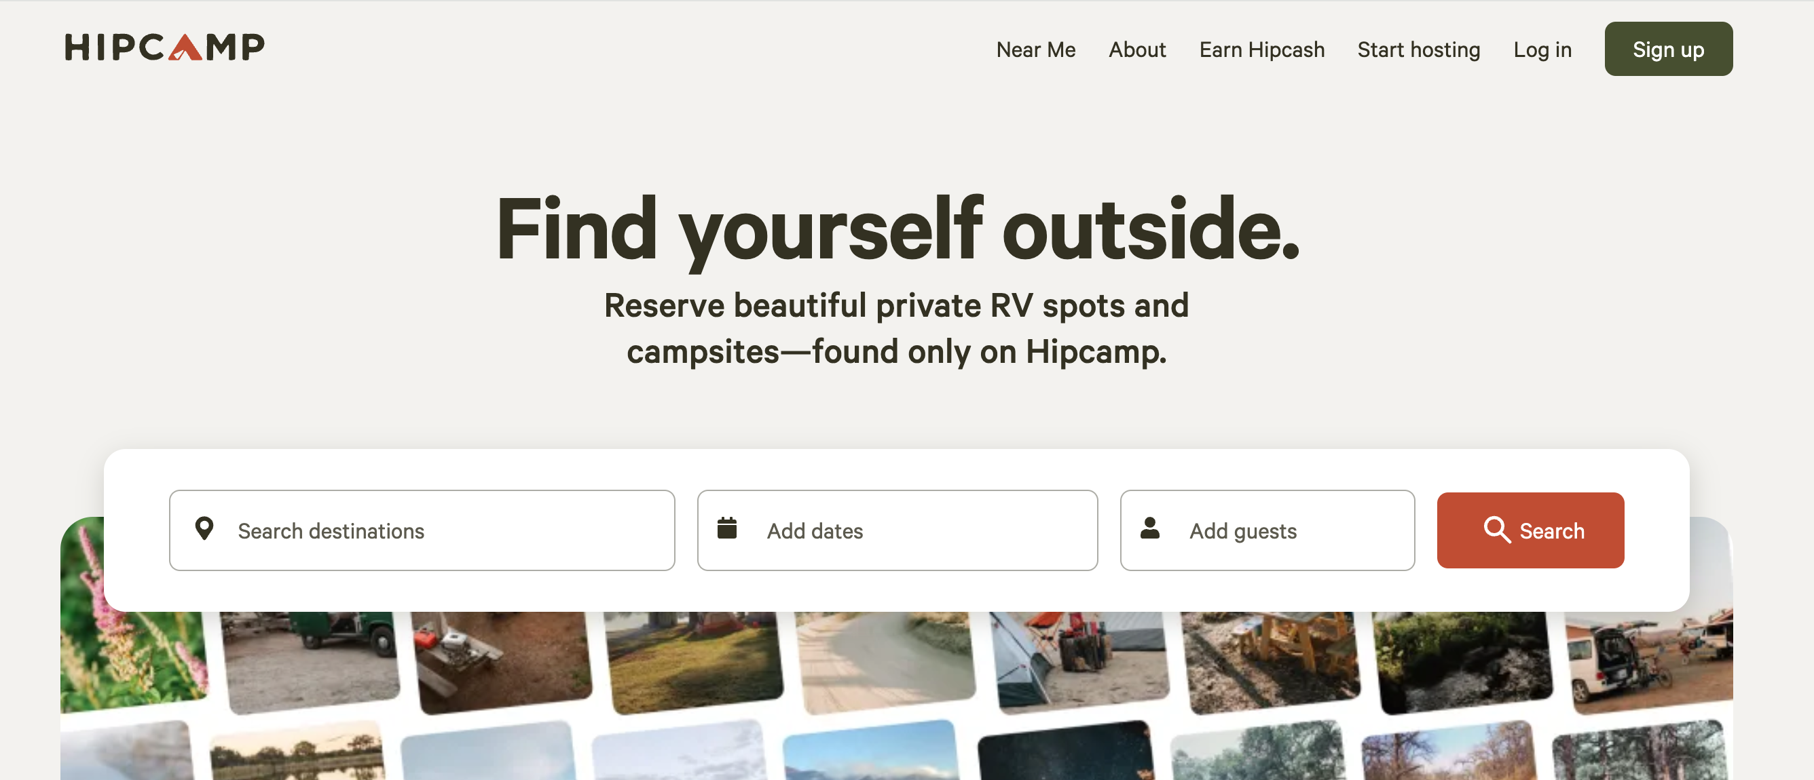
Visual Hierarchy Examples:
Not so Great ☹
Great!
Notes:
Here are two examples of visual hierarchy examples.
On the left we have the Berkshire Hathaway web page and on the right we have the hip camp webpage.
As you can see on the left there is no hierarchy all of the links are the same level so to say. So as a user we are unclear of what the main action we are suppose to take on this page on the right you can see clear visual hierarchy.
All the things we have talked about are coming together in this example. We have clear hierarchy with the bold title text drawing us in and that is supported by the sub title text below it all leading to a very clear cta.

Slide 20
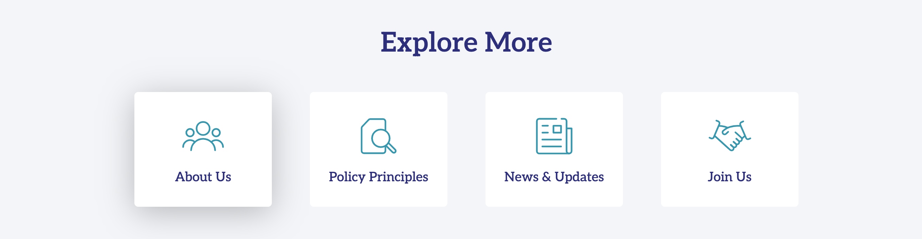
Visual Design: Content Grouping
Research
User Experience
Define CTA
Accessibility
Visual Design
Optimize for Mobile
Simple SEO
Additional Resources
Another form of visual design is content grouping:
  Visually group content that is similar
  Can be accomplished with the use of color, cards, icons, bullets and color blocks
Notes:
Another form of visual design is content grouping. I love content grouping! This is where you visually group content that is similar.
This can be done with the use of color, cards, icons, bullets, color blocks. These visual elements help organize similar content into distinct groups, making it easier for users to scan.
Here is an example of content grouping I used on a website to highlight and group the the most valuable subpages on the site

Slide 21
White space is your friend!
Research
User Experience
Define CTA
Accessibility
Visual Design
Optimize for Mobile
Simple SEO
Additional Resources
Whitespace is the area between the elements on a web page
  These elements can be: images, typography, and icons
Helps to balance elements on a page creating a natural flow for the user.
Improve readability by providing visual breathing room between elements. 79% of users are scanning content and only 16 percent read word-by-word
Can be used strategically to draw attention to important elements or calls-to-action (CTAs)
Notes:
Whitespace does not literally mean white pace it means the space that it between elements on a page so your images, typography, icons and text.
It is often used to balance elements on a page by creating a natural flow for the user to navigate through the content.
Using white space improves the readability of the page by giving the elements and text breathing room. When elements are crowded on the page its makes it much harder for the user to read and scan through the content.
Having a website that is easy to scan is important. A study done by the neilson group (the god father of user experience) shows that 79% of users scan website content and only 16 percent read word-by-word.
https://www.nngroup.com/articles/why-web-users-scan-instead-reading/
Can be used strategically to draw attention to important elements or calls-to-action (CTAs)

Slide 22
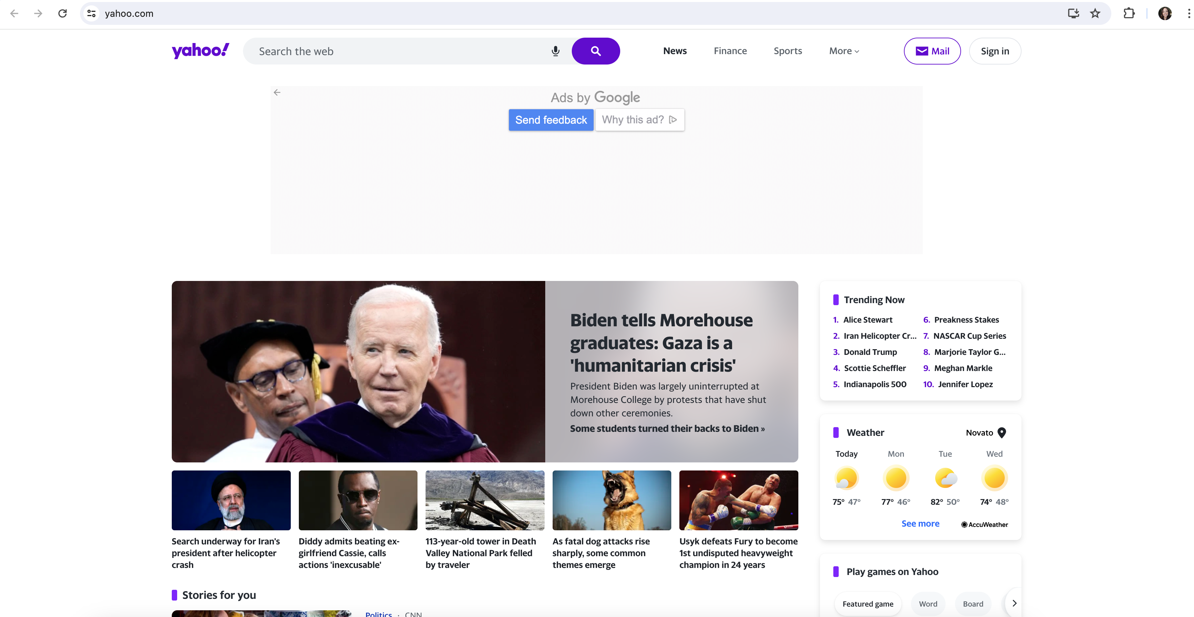
Is this a good use of whitespace?

Slide 23
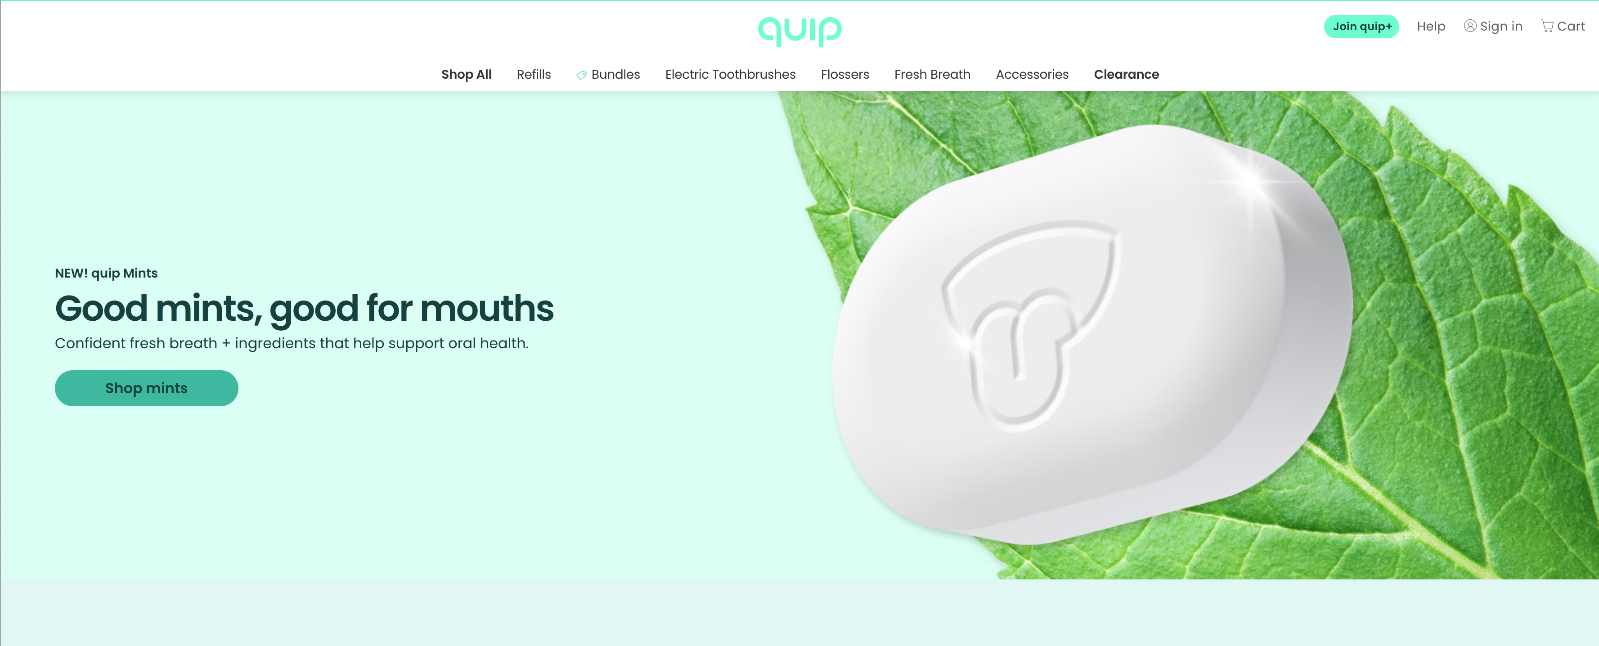
Is this a good use of whitespace?

Slide 24
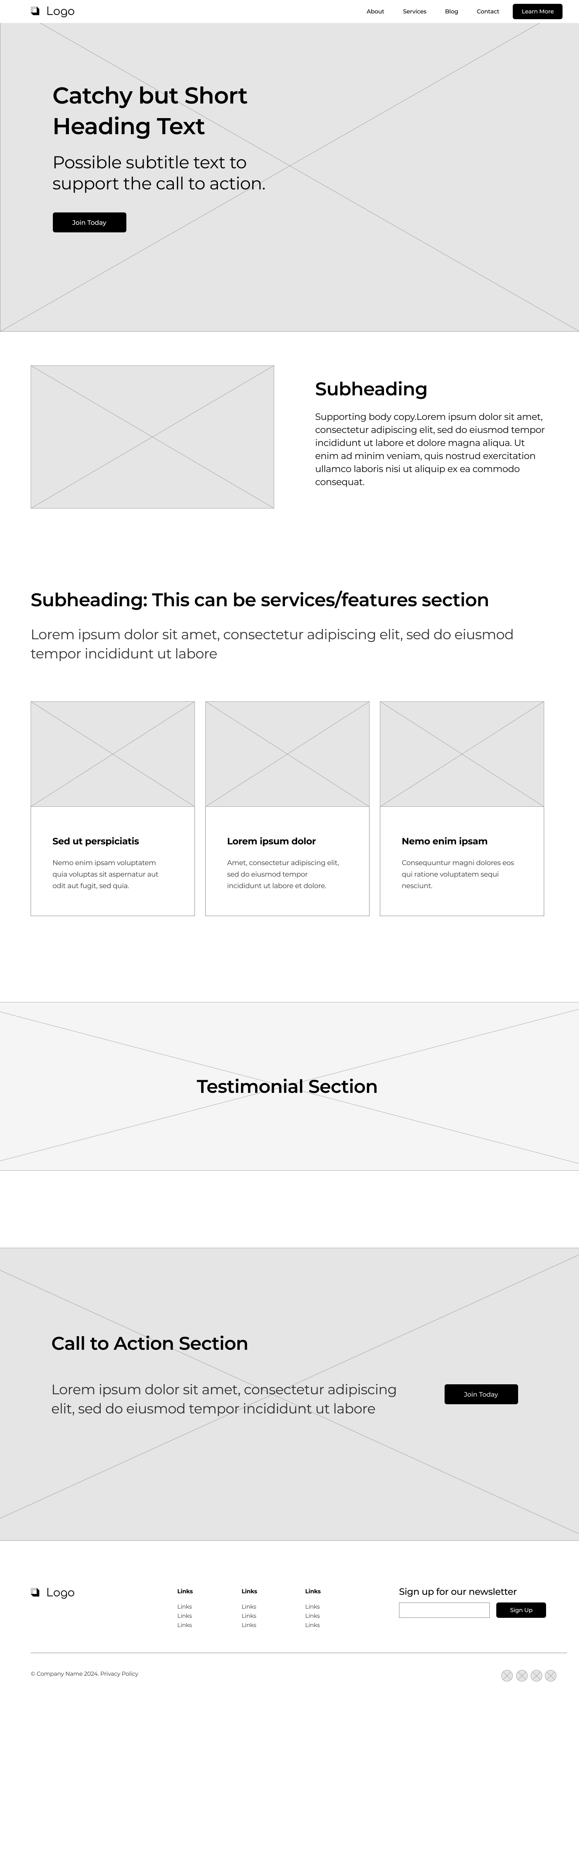
Research
User Experience
Define CTA
Accessibility
Visual Design
Optimize for Mobile
Simple SEO
Additional Resources
This is a sample
layout for a
homepage
design.

Slide 25
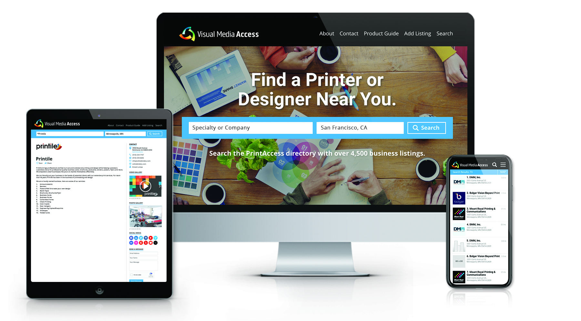
Responsive design is a must!
Research
User Experience
Define CTA
Accessibility
Visual Design
Optimize for Mobile
Simple SEO
Additional Resources
Ensures your site looks great on all size devices
Boosts user experience and keeps users on your site
SEO benefits: Google likes websites that are mobile responsive
Accessibility: Improved readability and navigational ease
In the United States, 85% of internet users access the internet through mobile devices¹
Notes:
Now that we have explored the ins and outs of visual deisgn we are going to talk about Responsive design and why it is essential to have a responsive website that is optimized for mobile.
Ensures your site looks great on all size devices
Boosts user experience and keeps users on your site because things will have resized to suit the smaller screen making navigation easier. If your site works well on mobile you are more likely to experience less user drop off
There are also seo benefits to responsive design. A responsive site will lead to better user experience can lead to longer site visits , lower bounce rates,and will have faster loading speeds which are positive signals for search engines and can improve SEO. More importantly google has move towards a mobile first indexing. Meaning Google predominantly uses the mobile version of a site's content, crawled with the smartphone agent, for indexing and ranking. Google does peanalize sites that are not responsive so you will not rank as high.
Accessibility: having a site that is responsive site is good for accessibility as it improves the readability, no one wants to zoom in and out on their mobile phone to read copy on a site. Responsive design will also adjust navigation menus, buttons, and other interactive elements to suit smaller screens making the site easier to navigate.
In the United States, 85% of internet users access the internet through mobile devices. So have you ever been on a road trip and you are the passenger tasked with finding coffee or food near where you are? What are you using to search for this, your phone! People are living on their phones these days so having a site that works and looks great on mobile is a non negotiable.
1 https://whatsthebigdata.com/mobile-internet-traffic/

Slide 26
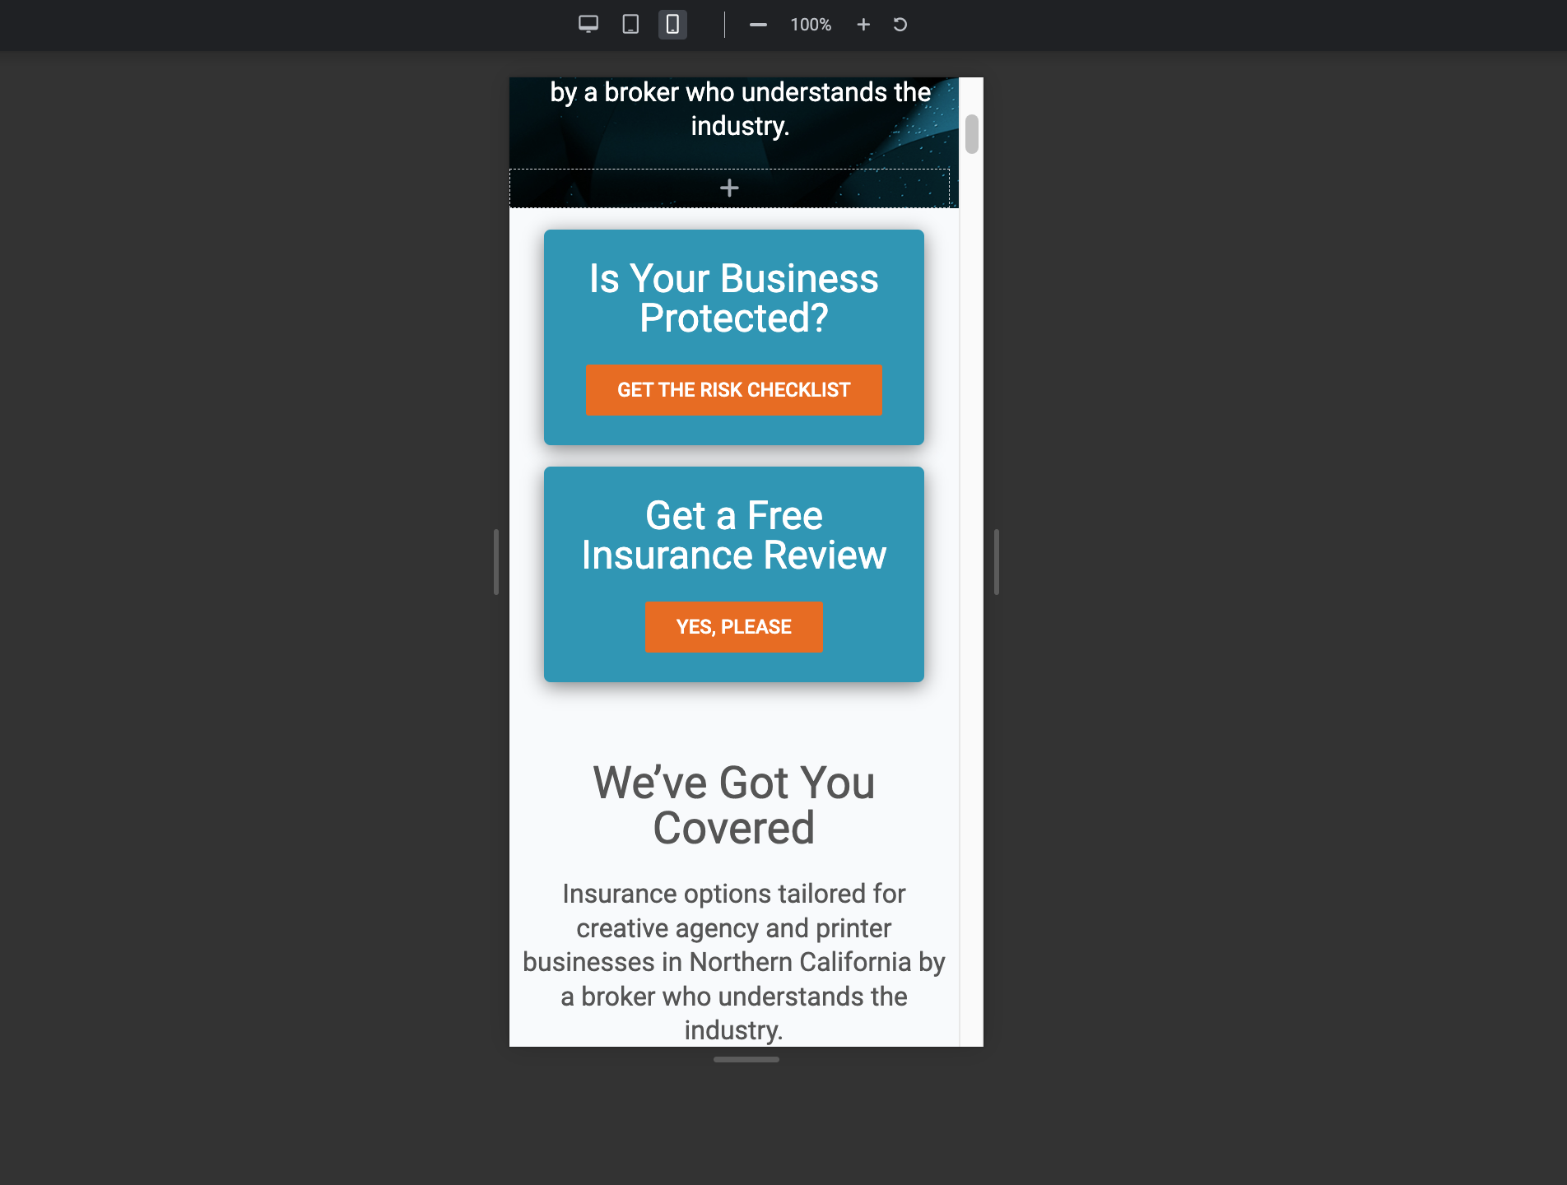
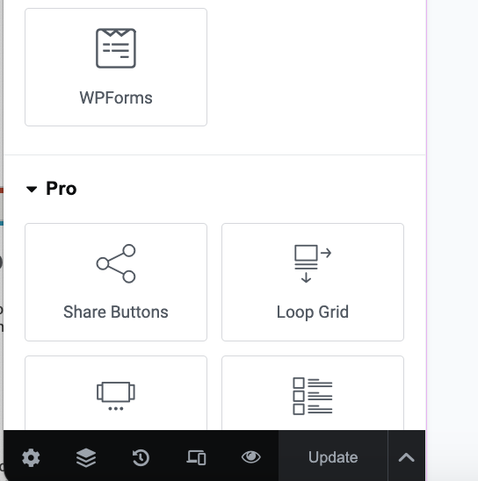
Responsive Design Tools:
Toggle between desktop, mobile and tablet
Responsive Design mode
Notes:
There are many tools out to help you create a responsive website. If working in any modern WYSIWYG builder there will be a responsive mode that you can swap to and adjust the layout for mobile and tablet. I recommend always checking the mobile layout as there will almost always need a few adjustments to the layout.
Here are examples of the elementor builder that we have used within wordpress to build the VMA website.

Slide 27
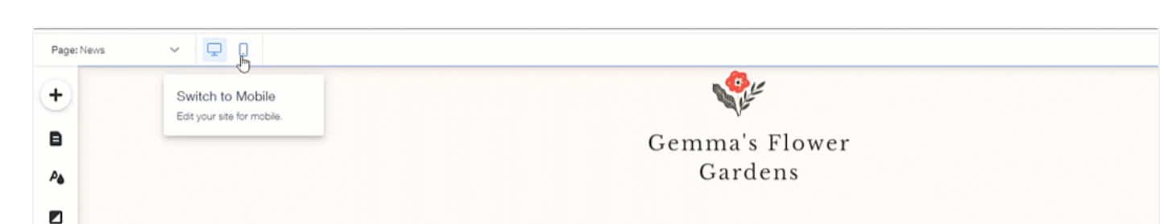
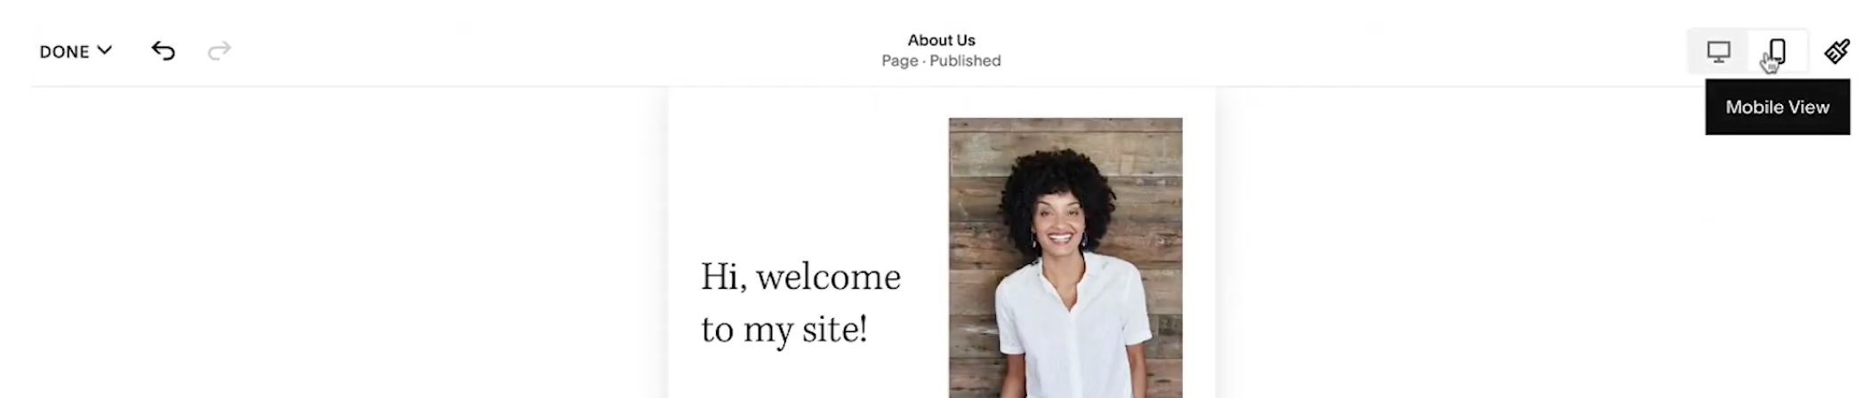
Responsive Design Tools:
Toggle between desktop, mobile and tablet
Toggle between desktop and mobile (no tablet)

Slide 28
Simple SEO Tips:
Research
User Experience
Define CTA
Accessibility
Visual Design
Optimize for Mobile
Simple SEO
Additional Resources
Keyword Research: What are your users typing in Google to search for you and your services?
    Ahrefs – 10 free keyword searches a day
    Moz Keyword Explorer – Requires an account
    WordStream Free Keyword Tool – 13 free keyword searches a day
  Include these in page headings (H1 tag), body copy and meta descriptions
  Avoid keyword stuffing
Notes:
A hot topic that I hear from so many is SEO. SEO can get technical but here are some simple tips that you can implement today.
Keyword Research: What are your users typing in Google to search for you and your services?
Conduct keyword research to identify relevant keywords and phrases related to your business and target audience.. Some websites with tools to conduct research are Ahrefs, Moz Keyword Explorer, and WordStream
We want to strategically include these in page headings, H1 titles, body copy and meta descriptions
We want to avoid keyword stuffing. Keyword stuffing is when you use the same keywords (or phrases) over and over again in your website’s content. It is generally very obvious to the user and has a really unnatural flow to it. So we want to make sure we are using our keywords strategicly where they make sense and sound natural.

Slide 29
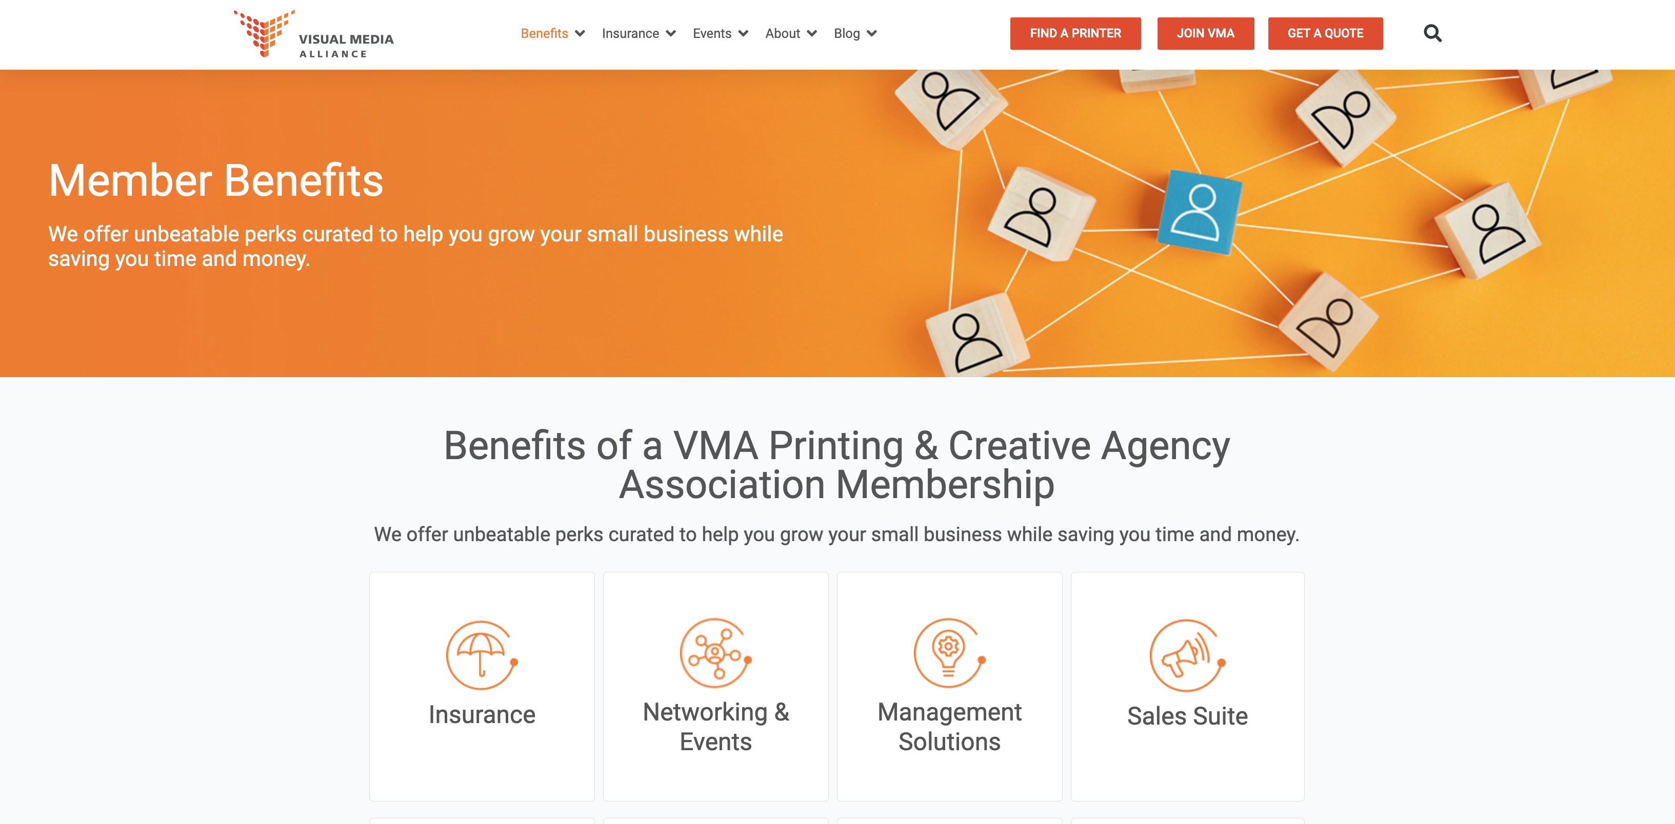
Simple SEO Tips:
Research
User Experience
Define CTA
Accessibility
Visual Design
Optimize for Mobile
Simple SEO
Additional Resources
Heading Structure
  H1 tag is the main “title” on your webpage
  Only one H1 tag per page¹
  Followed by H2, H3 etc.
  Use relevant keywords
H1
H2
H3
Notes:
Now we are going to talk about our heading structure which is also important for SEO.
Your Heading Structure refers to the titles on your page and we refer to those as H1, H2, H3 tags: Heading structure is important because it helps search engines and users navigate your website. Visually on the page your H1 tag will be the largest H2 will be smaller and H3 alittle smaller than h2
The H1 tag is the main title of your page, it is the most important title on the page as it helps search engines understand the content
It is best practice to only use one H1 tag on any web page followed by H2 H3 etc. Although with the implementation of HTML5 it states we are able to employ more than one H1 tag the google developer documentation style guide suggests that we stick with one. Using more than one H1 tag can potentially have negative affect your sites accessibility
Sometimes for visual effect you might want specific text on the page to be larger but have already implemented the H1 tag that’s ok! You can change the text size in the CSS code or in the editor you are working in.
. Within these title we want to make sure we are using relevant keywords as well.
1: https://developers.google.com/style/headings

Slide 30
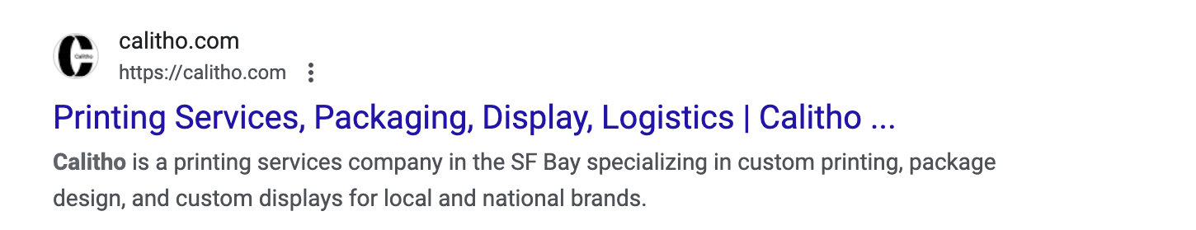
Simple SEO Tips:
Optimize page titles and meta descriptions.
  Accurately represent the content of each page and include relevant keywords.
  Use recommended character limits
    Page Title: 30 and 60
    Meta Descriptions:150-160
Research
User Experience
Define CTA
Accessibility
Visual Design
Optimize for Mobile
Simple SEO
Additional Resources
Page Title
Meta Description
Notes:
Optimize Page Titles and Meta Descriptions:
What are our title tags and meta descriptions. See the Calitho example below the bold blue text is the title tag of the page and the smaller grey text is the meta description. When your website shows up in a search result this is the information that is displayed
Write title tags that accurately represent the content of each page.
Also create unique meta descriptions for each page that summarize the page's content in a concise and engaging manner, encouraging users to click through from search engine results. If you don’t define the meta description Search engines like Google will automatically generate a snippet from the page's content to display in the search results. This snippet is usually pulled from the first few sentences of the page.
Ensure that page titles and meta descriptions are within the recommended character limits to avoid them from getting cut short.

Slide 31
Simple SEO Tips:
Create quality relevant content:
  Search engines prioritize content that is relevant, valuable, and well-written.
  High quality relevant content is more likely to naturally incorporate keywords which will boost SEO
Backlinks!
  Google views backlinks like recommendations
  The more backlinks a site has, the more trustworthy it’s perceived to be
  Not all backlinks are created equally
Research
User Experience
Define CTA
Accessibility
Visual Design
Optimize for Mobile
Simple SEO
Additional Resources
Notes:
Create quality relevant content:
Search engines prioritize content that is relevant, valuable, and well-written. High-quality content that answers users' queries effectively is more likely to rank higher in search results.
High quality relevant content is more likely to naturally incorporate keywords which will boost SEO
Backlinks!
Backlinks play a crucial role in SEO, as they are essentially like recommendations from other websites. When a another website or webpage links to your site , it's seen as a vote of confidence by the search engines. Especially if it comes from authorative reputable sources or from within the same industry or niche. The more backlinks a page or site has, the more trustworthy it’s perceived to be by serps and the higher it will rank
However, not all backlinks are created equal. Search engines, Google considers the quality, relevance, and authority of the linking site when evaluating the value of a backlink. Backlinks from highly authoritative and relevant websites carry more weight and can significantly impact a site's search engine rankings.
How do we get more backlinks:
Creating sharable content and making it accessible to others to share. Post it on social media!
Guest Blogging
Leverage Online Directories and Listings

Slide 32
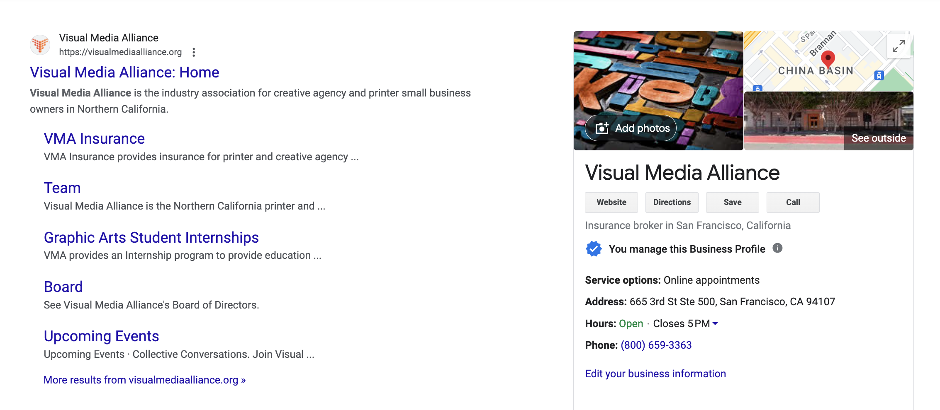
Additional Resources:
Research
User Experience
Define CTA
Accessibility
Visual Design
Optimize for Mobile
Simple SEO
Additional Resources
Google My Business: https://www.google.com/business/
  Great for local SEO
Notes:
You are going to want to sign up for these free google services
Google my business: Great for local SEO. When people search for businesses or services in their local area, GMB listings prominently appear in Google Search and Google Maps. This increases your chances of being discovered by potential customers.

Slide 33
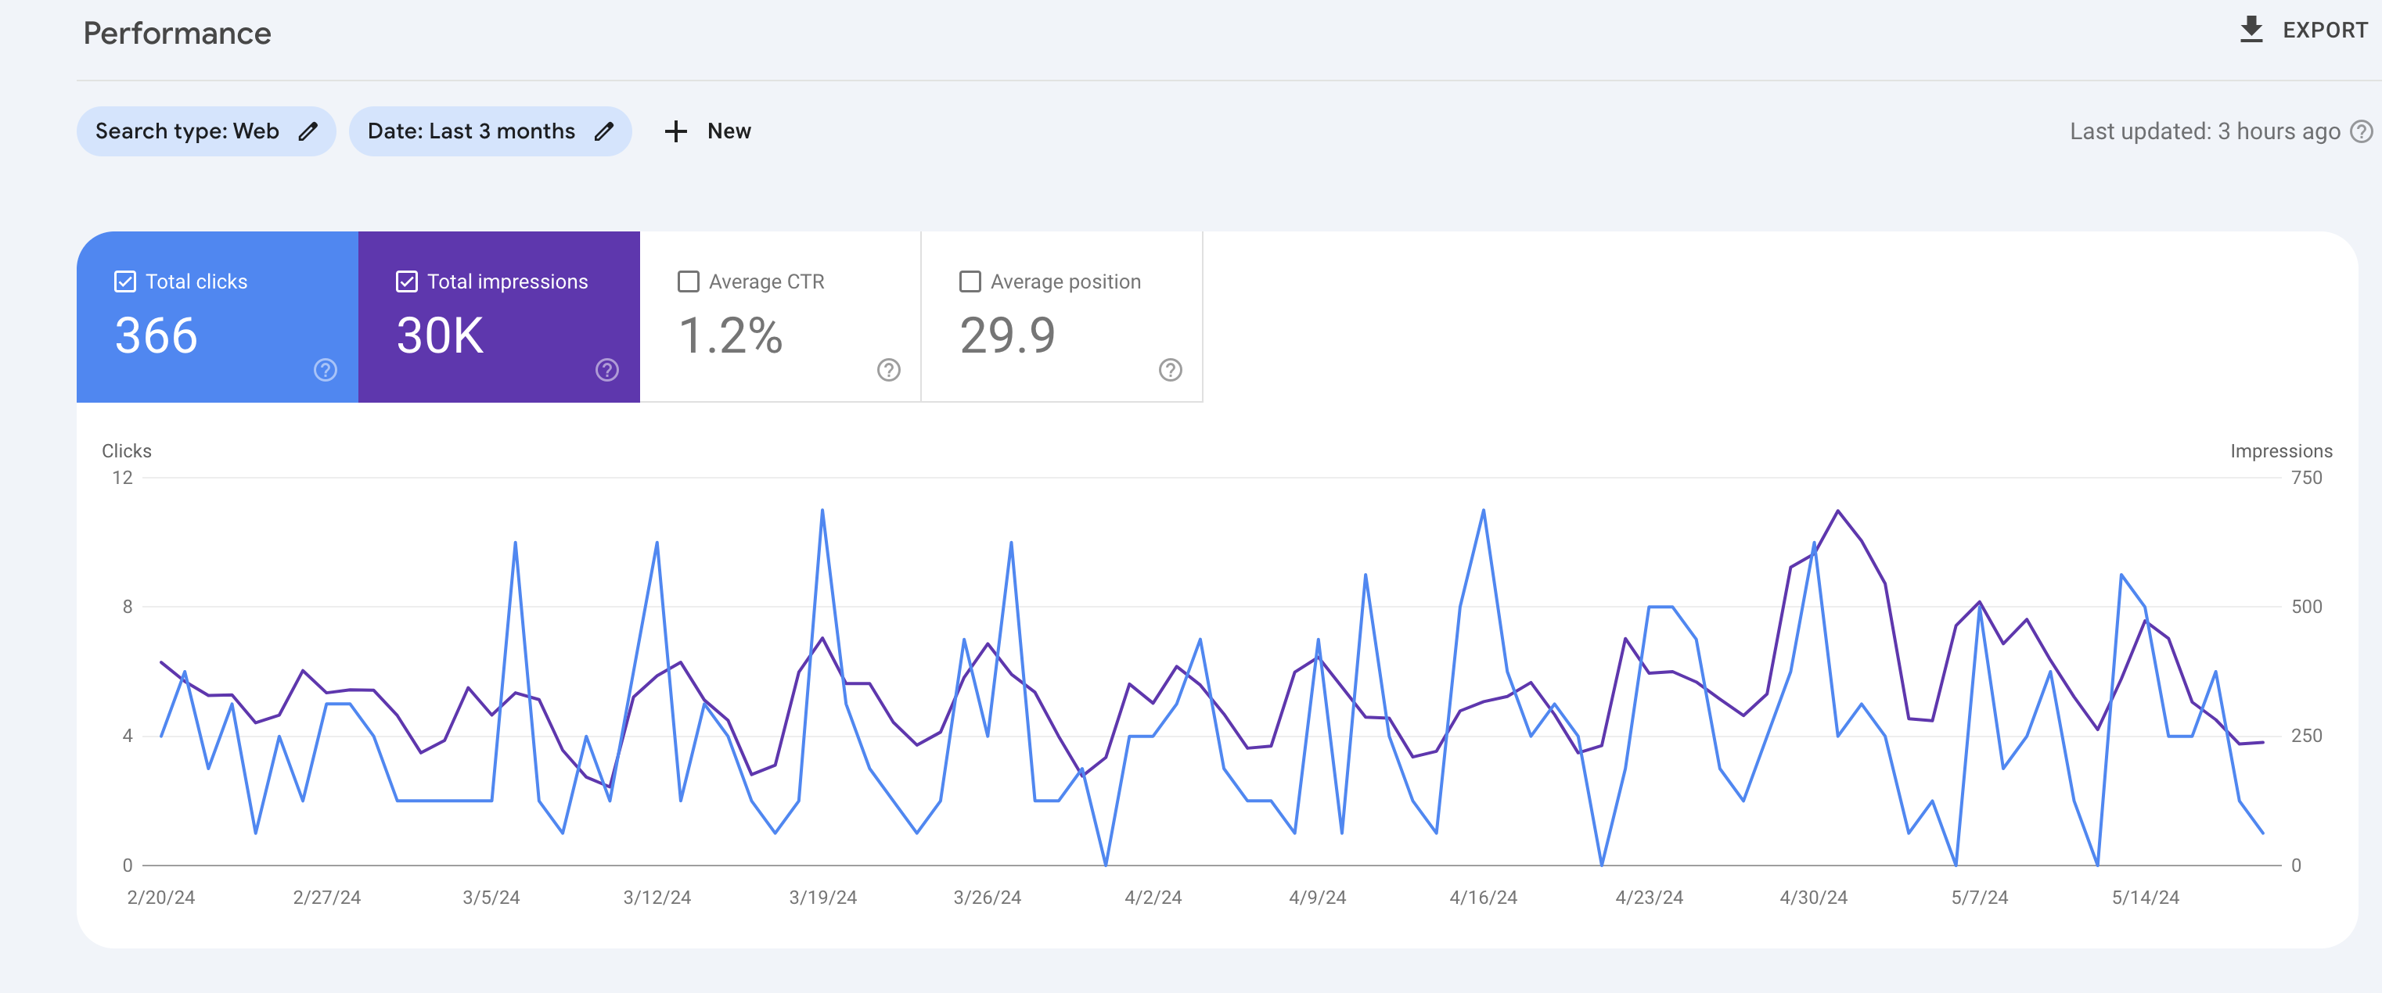
Additional Resources:
Research
User Experience
Define CTA
Accessibility
Visual Design
Optimize for Mobile
Simple SEO
Additional Resources
Google Analytics: https://marketingplatform.google.com/about/analytics/
  Track Users and Sessions, Pageviews, Bounce Rate, Traffic Sources and more!
Notes:
Google Analytics: Is a powerful tool for business owners to understand their website’s performance, visitor behavior, and overall effectiveness.
A few simple yet essential things to track:
Users and Sessions: Find the number of unique visitors to your website and the total number of visits, including repeat visits by the same user.
Pageviews – See your most viewed pages
Bounce Rate – see the percentage of users who leave without interacting with the page
Traffic Sources – Where your visitors are coming from.

Slide 34
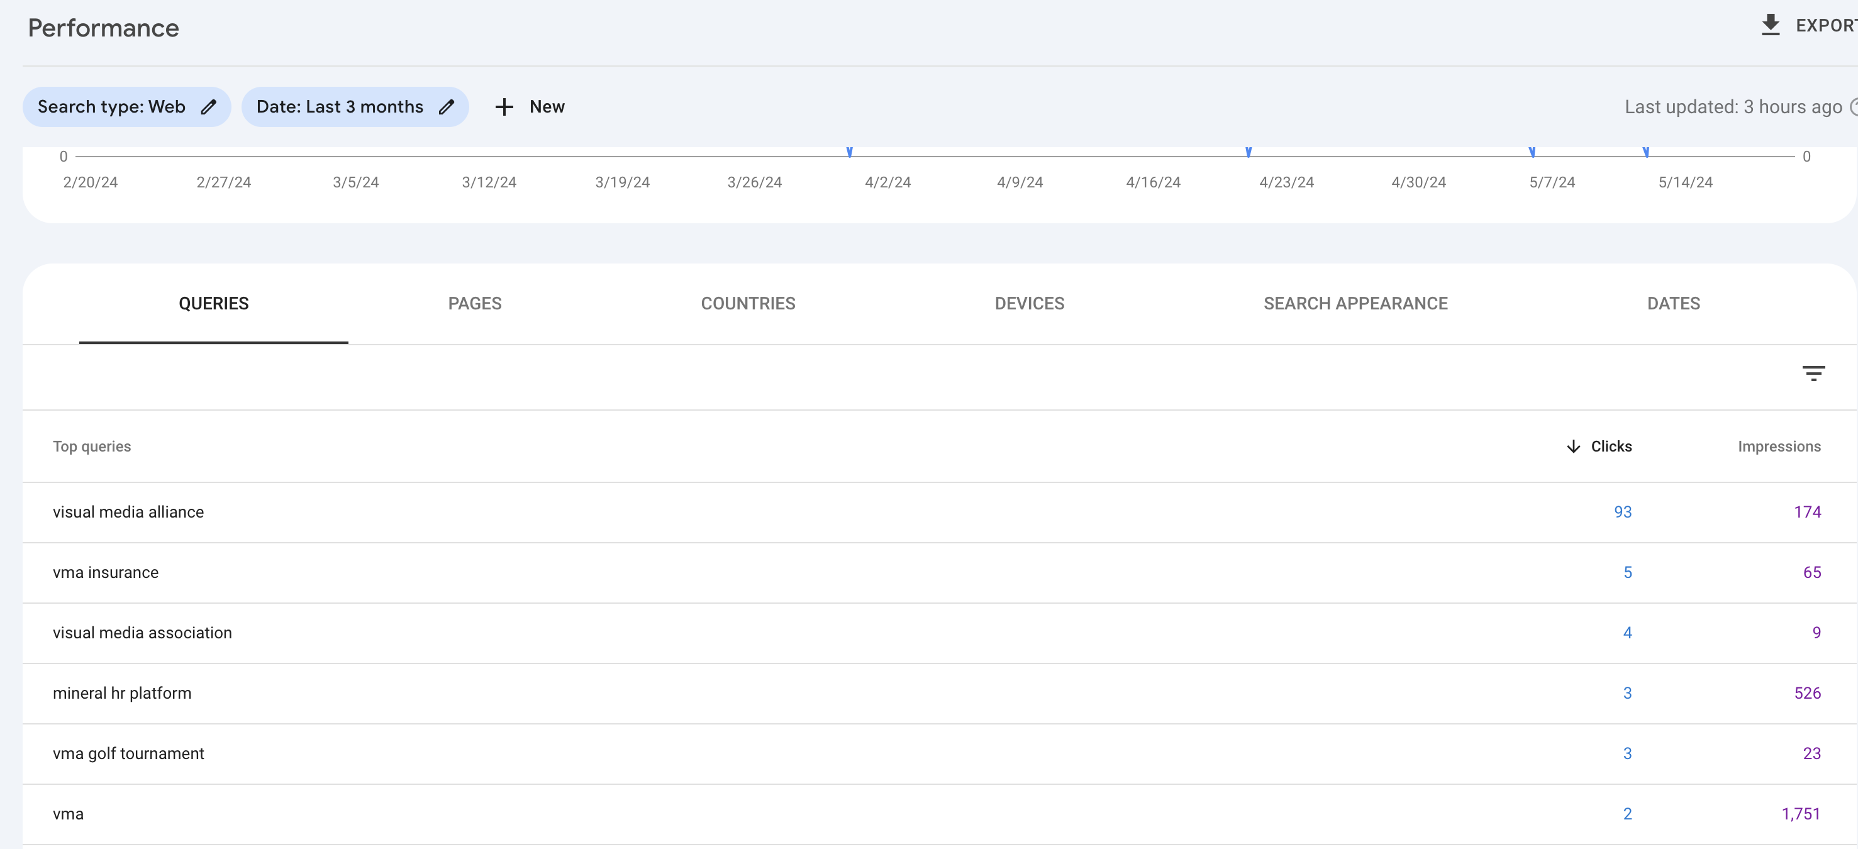
Additional Resources:
Research
User Experience
Define CTA
Accessibility
Visual Design
Optimize for Mobile
Simple SEO
Additional Resources
Google Search Console: https://search.google.com/search-console/about
  Make sure your site is being indexed
  See search engine results by queries
Notes:
Google search console: is another free tool provided by Google that helps website owners monitor, maintain, and troubleshoot their site's presence in Google Search results. You can view impressions and clicks per search query, check to see if your pages are being indexed which is HUUUUUGE,

Slide 35
Lets Connect!
Kathy Warren
Graphic and Web Designer
Katagraphics
kathy@katagraphics.com
www.katagraphics.com
Instagram: @katagraphics_designs
LinkedIn: https://www.linkedin.com/in/kathleenamaral/

Slide 36
Collective
Conversations
Thank you for joining us!
Register for upcoming Collective Conversations
and find slides at visualmediaalliance.com/collectiveconverations

