Slide 1
Collective
Conversations
Virtual Round Table Series
Saving Time with Marketing AI
April 17, 2024 @ 10AM
Sonali Shah
Head of Marketing
Visual Media Alliance
Notes:
Slides 4, 11, 12, 13 are just extra info for the audience and we can just say its in there to help them but skip over to create more discussion and dialogue rather than presentation.
Slide 10 - either I can take out or if we run out of time, they can do it as an exercise on their own.

Slide 2
What is AI?
AI stands for Artificial Intelligence.
Uses LLM - Large Language Models - type of AI program that can recognize and generate text, among other tasks using huge data sets. Essential a giant flow chart
A new-ish technology that enables machines to learn from the given data and identify hidden patterns.
The Point is: It facilitates the automation of manual tasks and provides required solutions without much human intervention.
Overall, it aids business decision making and can make marketing and other tasks easier.
Actually, its been around for quite a while
There are many marketing applications...
Notes:
some people think ai can also stand for augmented or assisted information
we’ve been using it unknowingly, to select and blur out a background for example or having mailchimp select the best time to send out a newsletter or a chatbot like you mention.

Slide 3
True or False?
It will take jobs from humans? Rest assured, it's been around for years and while it will make changes like the internet did, it should really make our lives easier.
Small businesses don't trust artificial intelligence.
They’re struggling to understand what AI is, how to apply it to their marketing, and whether or not it’s worth their time to adopt AI tools.
They think AI is too expensive—reserved for big businesses with even bigger budgets.
And they’re naturally wary of dropping the ball by giving control of their business to new technology.

Slide 4
Or so we thought – the Truth:
It turns out there are a few more layers to this story.
We expected misunderstanding, skepticism, and disinterest.
Digging deeper, Unbounce's survey of small businesses across North America revealed the opposite:
Small business owners are fully aware of how AI can help them juggle everyday challenges, supporting and enhancing their marketing efforts.
They anticipate that AI-powered marketing tools will see widespread adoption in the next two to three years.
About a third of them already use AI to improve their bottom line and grow their business.
Do you agree?
Are you curious about its potential?
Have you started using AI for your marketing?

Slide 5
Do Small Businesses Need Expertise to Implement AI in Marketing?
Mostly, No! There are many AI tools in marketing that provide a user-friendly interface and customer support system. Moreover, the websites and apps usually have the instructions mentioned specifically.
However, some tools may require basic knowledge and some are more advance. It's essential to do your due diligence, compare features and prices and then, choose the AI tools that best suit your business requirements.
You still ALWAYS want to ensure the human component.
And consider legalese.
How many are currently doing using AI in marketing activities?
When did you start?
Why are you doing it?

Slide 6
Why You Should be Using AI in Marketing
AI can be used for numerous parts of marketing from market research to content creation, lead nurturing, social media management, optimization and more.
It reduces marketing effort and costs and saves time and resources.
AI enables the automation and optimizations of various manual tasks thereby improving the overall efficiency and effectiveness of business processes.
It covers a broad range of tools including, chatbots, recommendation engines, content creation software etc. that help in enhancing the user experience and driving more sales and conversions.
Though AI has been transforming the marketing process across businesses of all sizes, the impact has been huge particularly on small businesses.
What are hesitations about using AI for your marketing?
Don't know where to start?
Don't have someone to do it.
Don't know what tools?
Other?

Slide 7
Why You Should be Using AI in Marketing
AI can be used for numerous parts of marketing from market research to content creation, lead nurturing, social media management, optimization and more.
It reduces marketing effort and costs and saves time and resources.
AI enables the automation and optimizations of various manual tasks thereby improving the overall efficiency and effectiveness of business processes.
It covers a broad range of tools including, chatbots, recommendation engines, content creation software etc. that help in enhancing the user experience and driving more sales and conversions.
Though AI has been transforming the marketing process across businesses of all sizes, the impact has been huge particularly on small businesses.
What are hesitations about using AI for your marketing?
Don't know where to start?
Don't have someone to do it.
Don't know what tools?
Other?

Slide 8
Some Things to Be Aware Of
No matter how good the output, AI is still not human generated content, so you need to be cautious about usage.
Ethical considerations & watch out for plagiarism. It's getting content from the web.
Watch out for accuracy. It's been known to hallucinate or make things up
Edit to make sure it doesn't sound AI-written and is in your company's tone of voice and human sounding
Know that there is already lots of spamming and corruption in AI – be cautious
Make sure the app you use for images or copy allows for commercial usage – these are changing all the time and are usually about free vs free
Data privacy and security concerns: Can other people access the content you create? How is the output of generative AI programs stored? For example, you may need an encrypted server. These are serious questions, particularly if your business deals with personal data and confidential information.
Notes:
Some copyright-infringing GPTs have been ripped from movie, TV, and video game franchises (without proper authorization), allowing users to “chat” with copyrighted characters.
OpenAI prohibits GPTs that promote academic dishonesty, but the store has GPTs that claim to be “undetectable” by AI plagiarism content detectors, like Copyleaks.
GPTs that impersonate people without consent are also forbidden, but chatbots are impersonating political candidates and public figures, like Elon Musk and Taylor Swift.

Slide 9
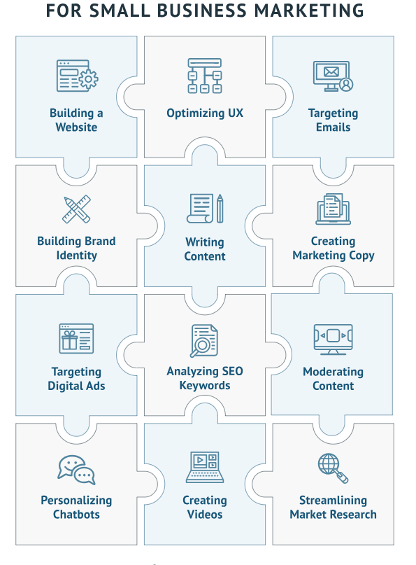
The Many Ways AI Can Help Your Marketing
Which of these are you using AI for?

Slide 10
Today We'll Discuss AI for:
Market Research – audience research, customer jouney mapping, tactic generation, trend analysis,
Content Strategy – idea generation
Copywriting – blogs, social media, sales materials, emails subject lines and content, content.
Image creation – images for emails, enewsletters, social media, lead gen, brochures etc.
Which of these are you using AI for?
Other AI applications to be aware of:
Branding
Email Marketing
Website
Social Media
Video creation
SEO
Optimizations
ABM
Analytics

Slide 11
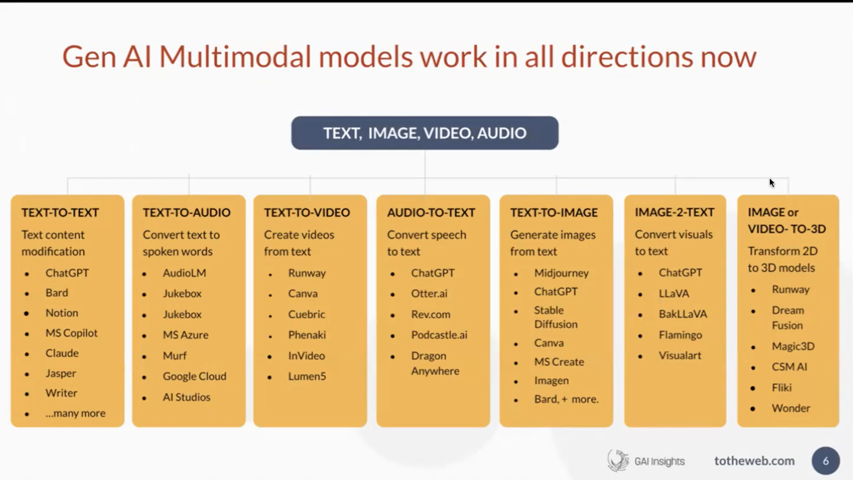
Lots of AI Marketing Tools Already

Slide 12
Some AI Use Tools
General | Branding | Writing | Images
Brainstorming Research Strategy Writing | Consistent brand voice Consistent design | Copywriting Editing Proofing | Image creation
^{ChatGpt} ^{Antropic Claude} ^{Bing Co-pilot} ^{Google Bard} These have free and paid versions | ^{A Custom ChatGPT} ^{BrandGuard} | ^{Grammary} | ^{Canva} ^{Adobe Firefly} ^{Midjourney} ^{Dall-e}
Which of these are you using AI for?
What AI tools are you using or have used?
Why do you like them or not?
Notes:
ChatGPT Paid - lets you secure your data by turning off your history, can talk to it, incorporate images)
Custom ChatGPT for Branding – enables users to train their own chatbots on brand vice to generage copy- want to turn on private browsing to make sure ChatGPT doesn’t retain

Slide 13
Effective Prompting is Key
Ask the app the question you want answered:
Define exactly what you're looking for. Be clear – Tell it exactly what you are looking for
Tell it the tone of voice to use and any editorial style directions. Give it example copy in the right tone to replicate
How you want it to display the output (text, chart, image)
Get specific with goals
Experiment and refine
Ask me 15-20 questions to better understand my business, my audience, my values and my tone of voice.
Is there anything else I should ask you to get a better answer or solution to my question?
Notes:
In the paid version of ChatGPT you can even get Promp engineering app

Slide 14
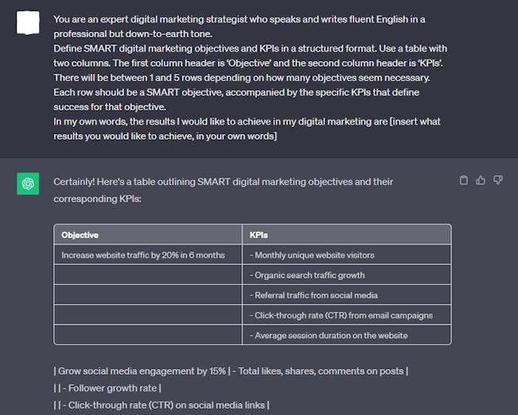
Source: Digital Marketing Institute

Slide 15
Sample Prompts
Generate ideas for a new product launch in [month] that incorporates the theme of [season] and [tone].
Brainstorm content ideas for a blog post about [topic] in [number] of words or less that is search engine optimized in formatting using H2s and H3s accordingly.
Identify popular trends in the industry of [product or service] that an audience of [target audience] will be interested in this [upcoming season].
Generate ideas for an upcoming marketing campaign about [new product] with a marketing mix consisting of [product] [price] [place] [promotion channels].
Suggest [number] ways to improve website traffic during [holiday season].
Identify potential target audiences in [location] that would be interested in buying [product] to solve [pain point].
More sample prompts

Slide 16
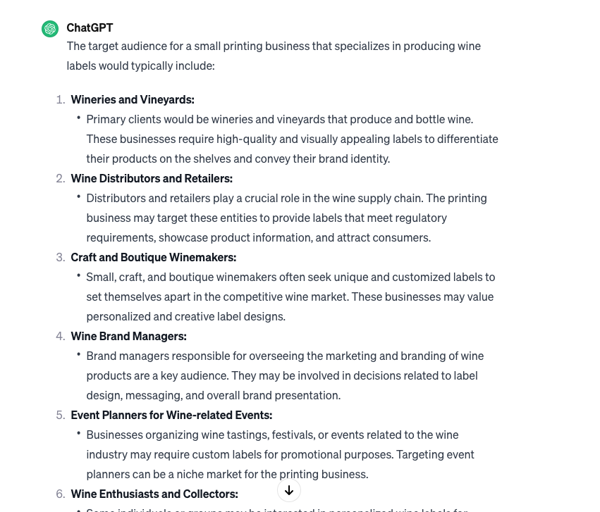
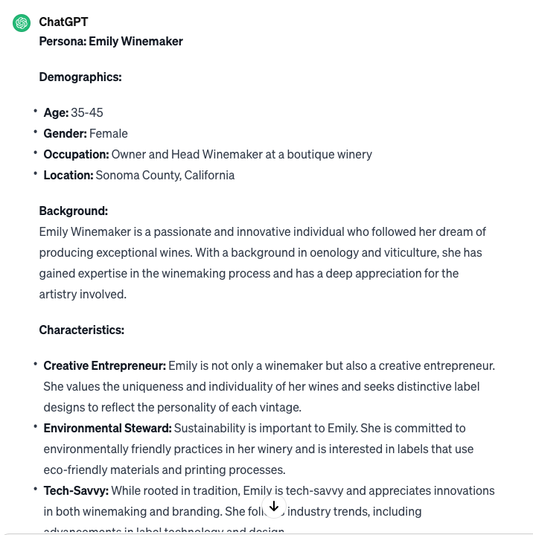
Using AI for Market Research - ChatGPT
Q: Describe the target audience for a small printing business that makes wine labels:
Q: Please create a persona for the winery target buyer for the labels. Include their demographics and other information that would be helpful for marketing purposes.

Slide 17
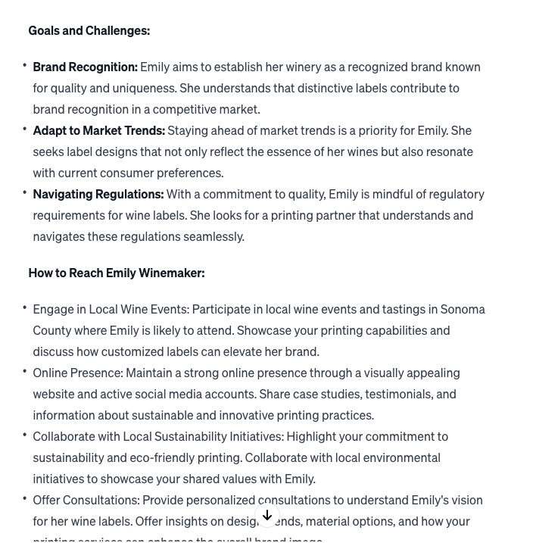
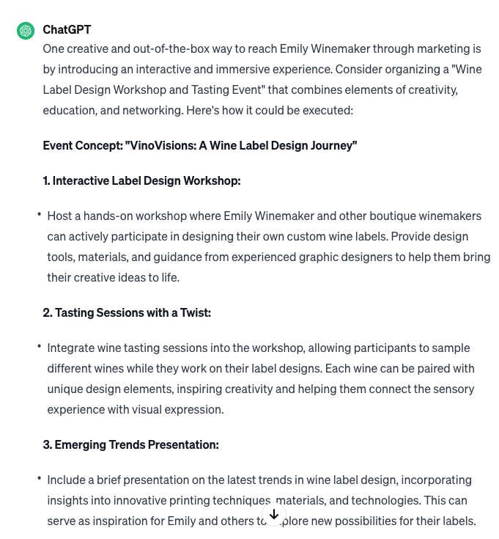
Using AI for Market Research - ChatGPT
Q: Please create a person for the winery target buyer for the labels. Include their demographics and other information that would be helpful for marketing purposes.
Q: What's a creative out-of-the-box way to reach this persona thru marketing?

Slide 18
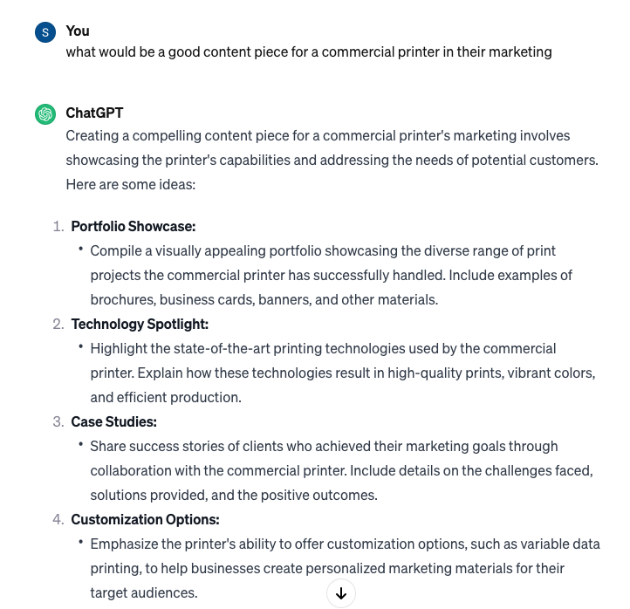
AI Content Creation: Ideas & Enhancement
AI can save time and resources
Create high-quality content
Still requires human expertise
Can help businesses create content more efficiently by:
Suggesting topics:
  Offering types of content eg. Ebook, blog, video
  Generating outlines for blog posts, articles, and other content. AI can help small businesses create engaging content, improve SEO, and boost website performance.
  AI can also generated keyword analysis, and content performance tracking to improve marketing results
AI marketing statistics show that over 44% of small businesses are already using AI to create content.
Notes:
AI marketing statistics show that over 44% of small businesses are already using AI to create content.

Slide 19
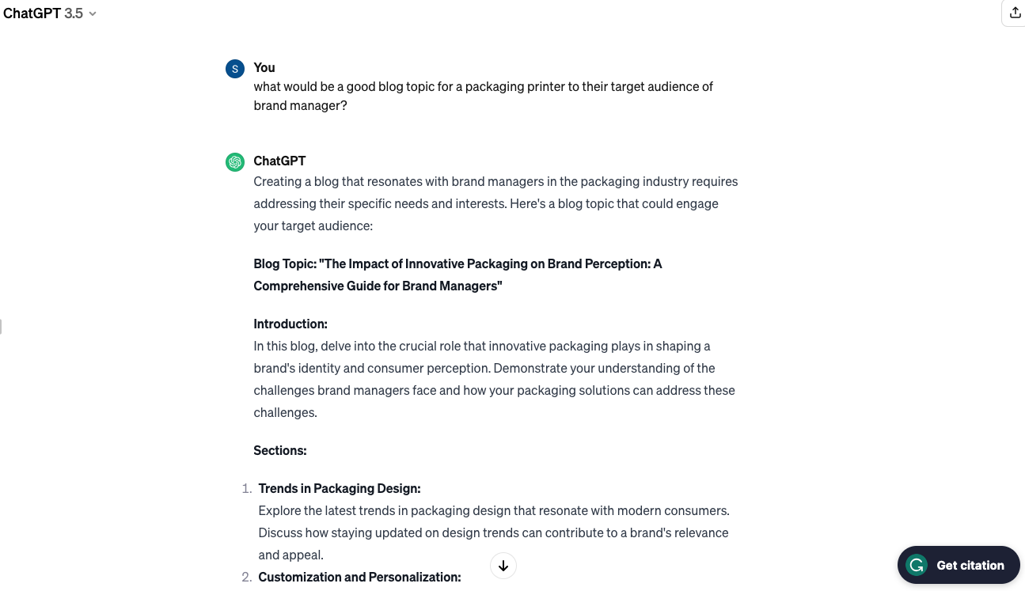
AI Content Creation: Copy
Copy is fundamental to all marketing. AI can help with drafting product description, email copy
, blog posts or social media posts
Some AI-powered content creation tools are available such as:
  Grammarly acts as a virtual writing assistant to review your spelling, grammar, and more.
  Jasper.ai
  Copy.ai
  Chatbots like ChatGPT can also write but are even better for simplify the research process by answering prompts.
These tools help you create long form copies within a few minutes.
Must still use human expertise to ensure it reads properly and accurately and does not look like it was created with AI

Slide 20
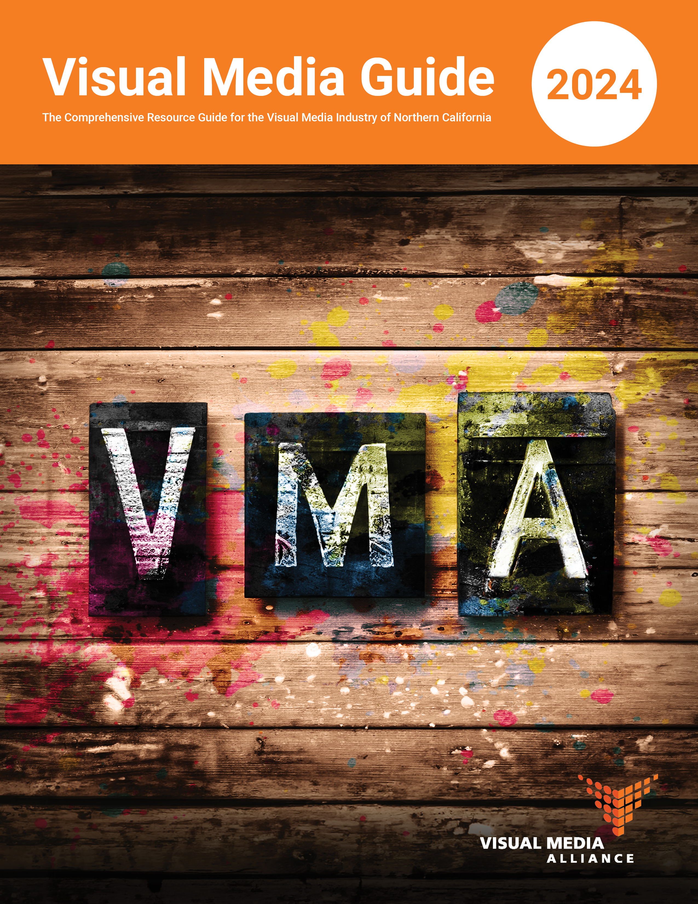
AI Content Creation: Design
The visual element of marketing is essential and AI makes this easier.
Content may not be as on-brand or polished as using a designer or agency, but there is a lot that can be done as a novice or even professionals are combining AI design output with their creative expertise.
AI design tools:
  Canva - has a free option
  Midjourney - no longer a free option but v affordable. Cheaper plans go into public domain. Stealth mode plan to prevent others using your images.
  Dall-e - also a free option, credits expire if you don’t use them
  Adobe Suite and Express
  Many more and new ones seems like everyday
Ensure commercial use with the tool you use.
Insert cover of the Guide that Kathy did using AI and photoshop
Notes:
Magic Media - Canva's AI image generator powered by Stable Diffusion lets you choose image variations based on a preferred look and composition. Generate up to 50 images on a Free subscription, or upgrade to Canva Pro for 500 uses per user per month
Can Midjourney images be used commercially?
Yes, you can use images generated by Midjourney for commercial purposes. To do so, it's important to ensure that during the generation process, the user is logged into their account and subscribed to one of Midjourney's subscription plans

Slide 21
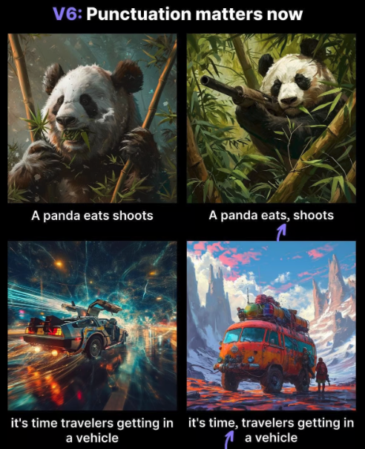
AI Content Creation: Design Prompts
Write prompts that make sense
Don’t be afraid to expirment
Be clear and specific
Set the content
Ask open ended questions
Specificy the format
Use follow-up prompts
Specify the style
Upload photo reference
Midjourney example from Superhuman AI

Slide 22
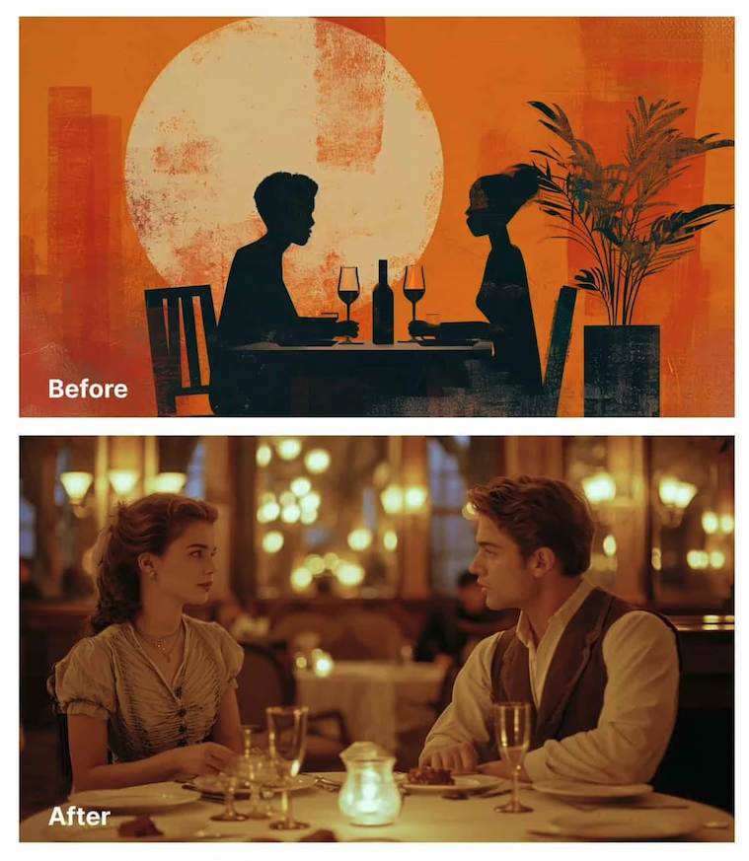
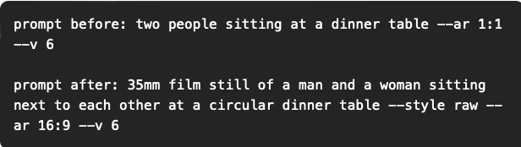
AI Content Creation: Design Prompts
Have you used any AI copy or design tools?
Which do you recommend for your colleagues?
Midjourney example from Superhuman AI

Slide 23
Collective
Conversations
Thank you for joining us!
Register for upcoming Collective Conversations
and find slides at vma.bz/cc/

